Slide 1
RAMATHRA FORT
P.O. Sapotra, District Karauli
Rajasthan, India
www.ramathrafort.com

Slide 2
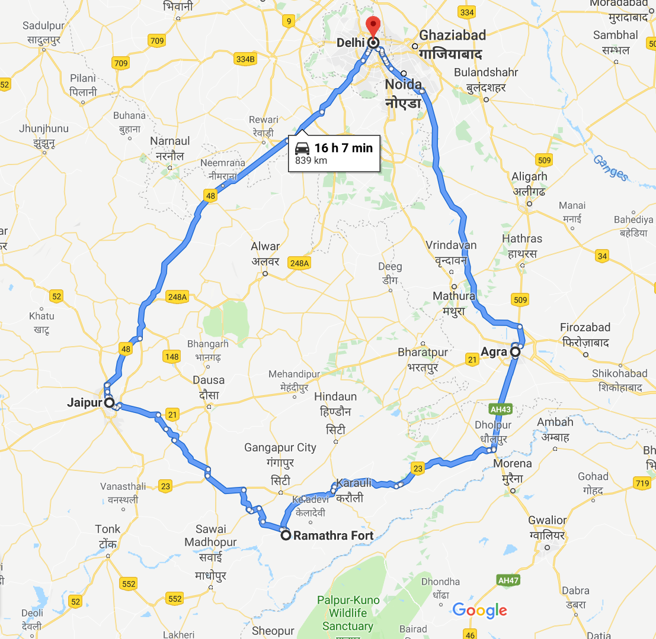
The Golden Triangle with a ‘RARE’ twist !
Delhi -> Agra -> Ramathra Fort -> Jaipur -> Delhi
Delhi – Agra (220 Kms / 4h) – Ramathra Fort (205 Kms / 5 h) – Jaipur (167 Kms / 4h) – Delhi

Slide 4
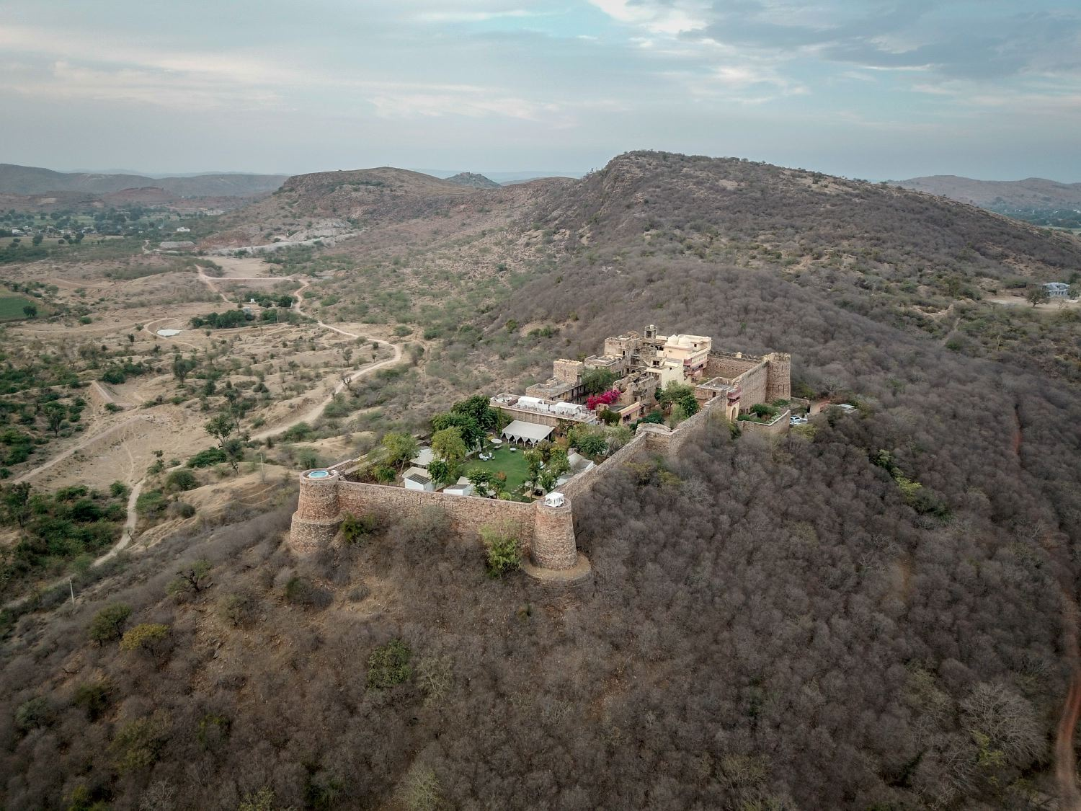

Slide 7
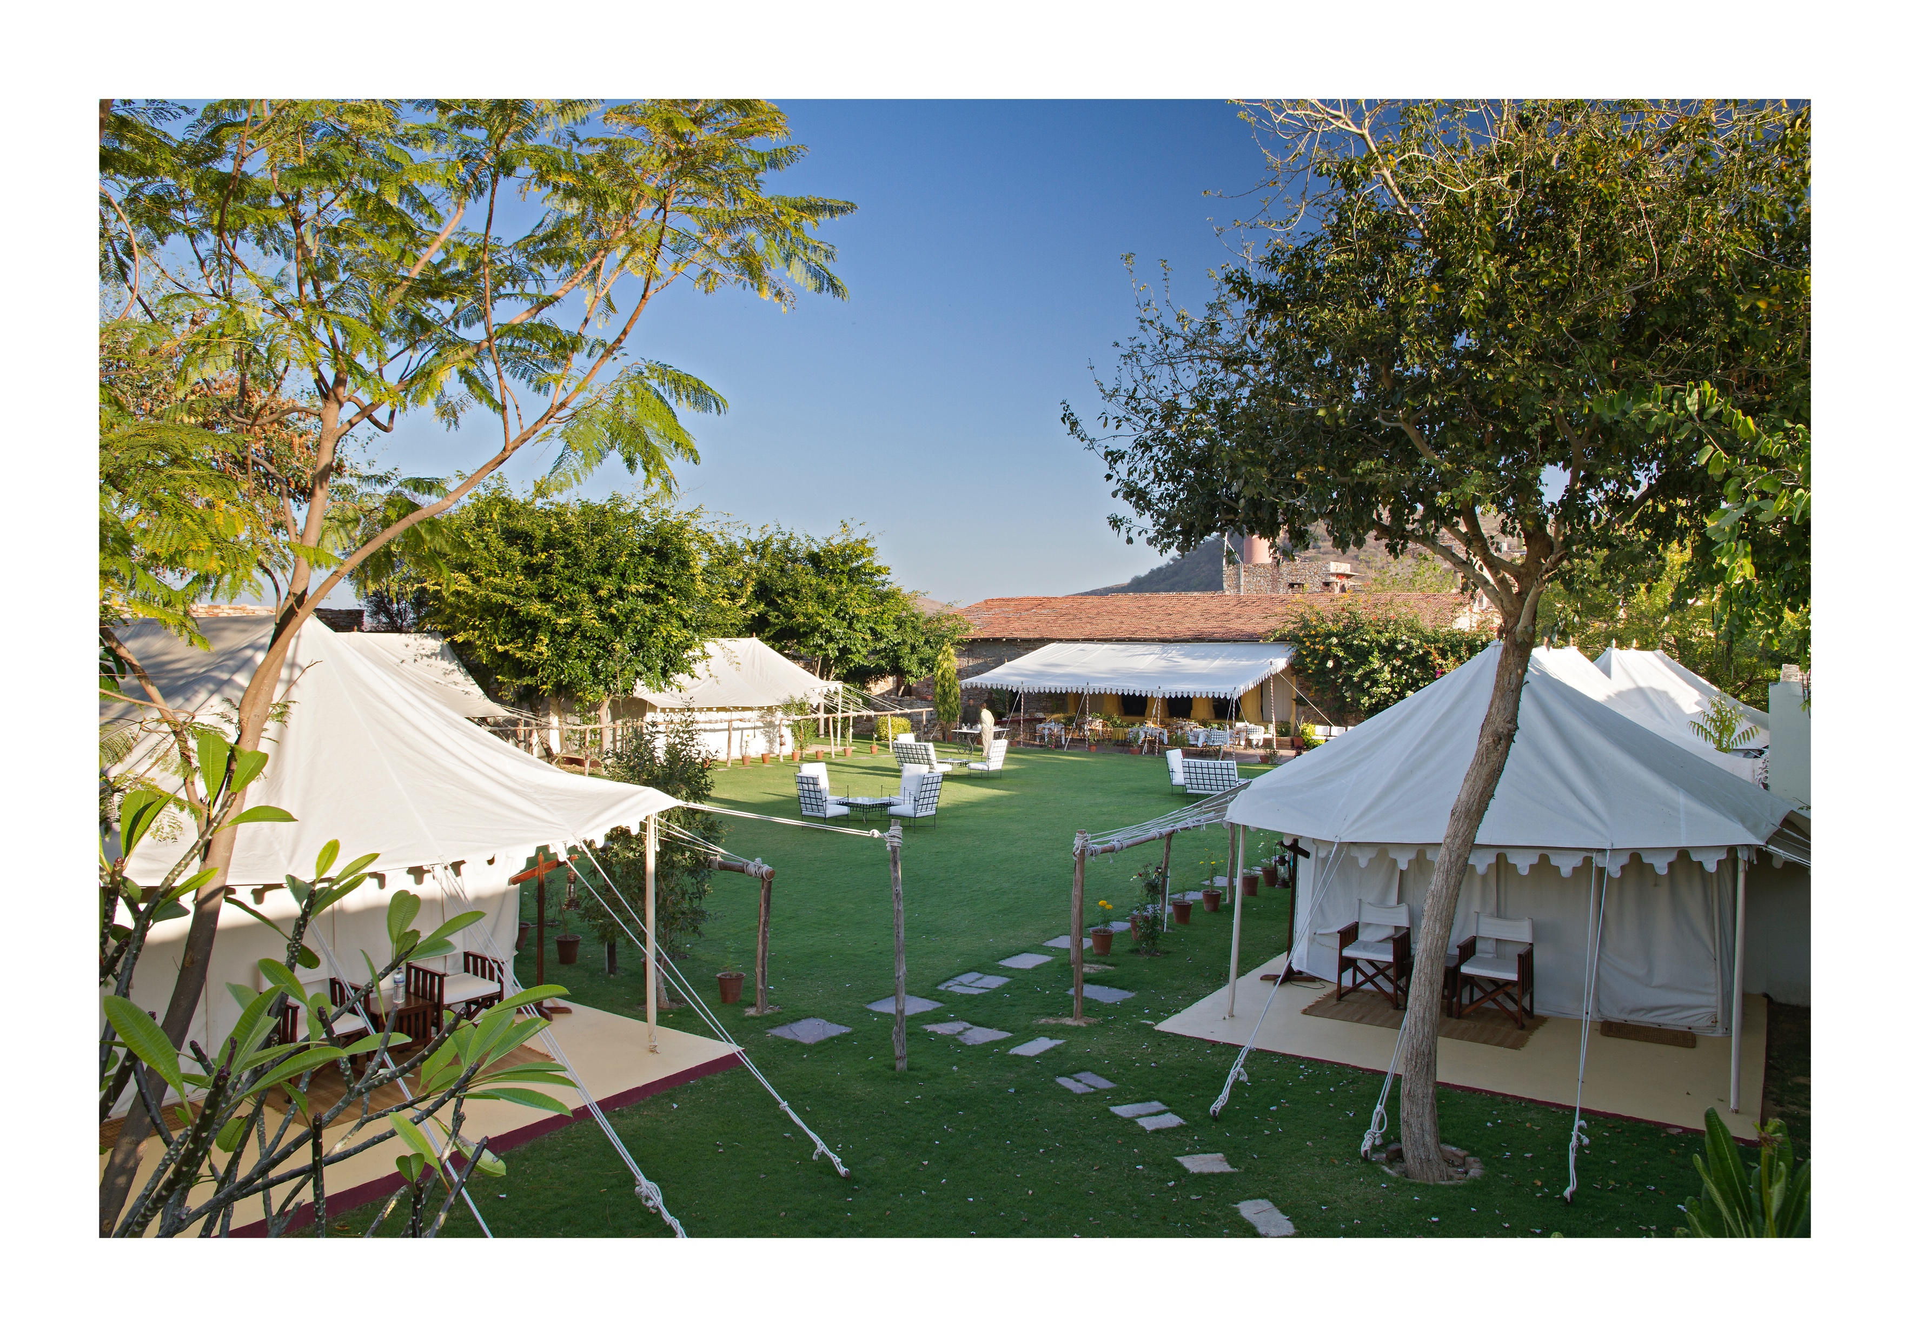

Slide 8
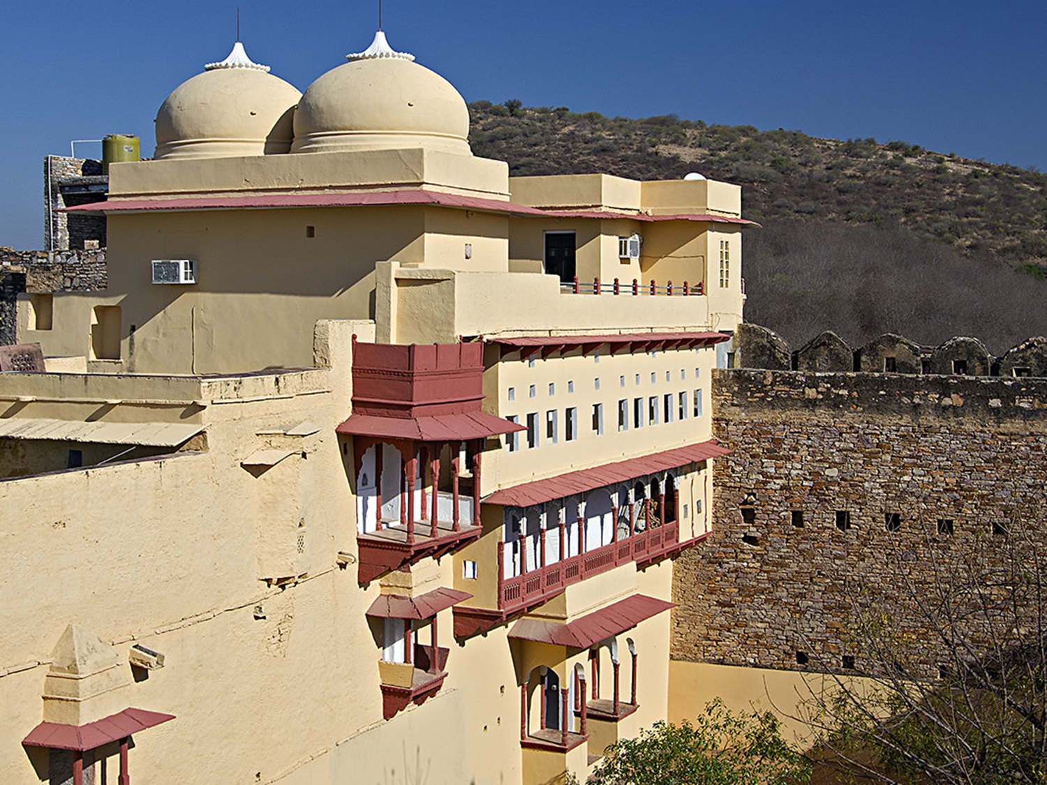

Slide 9
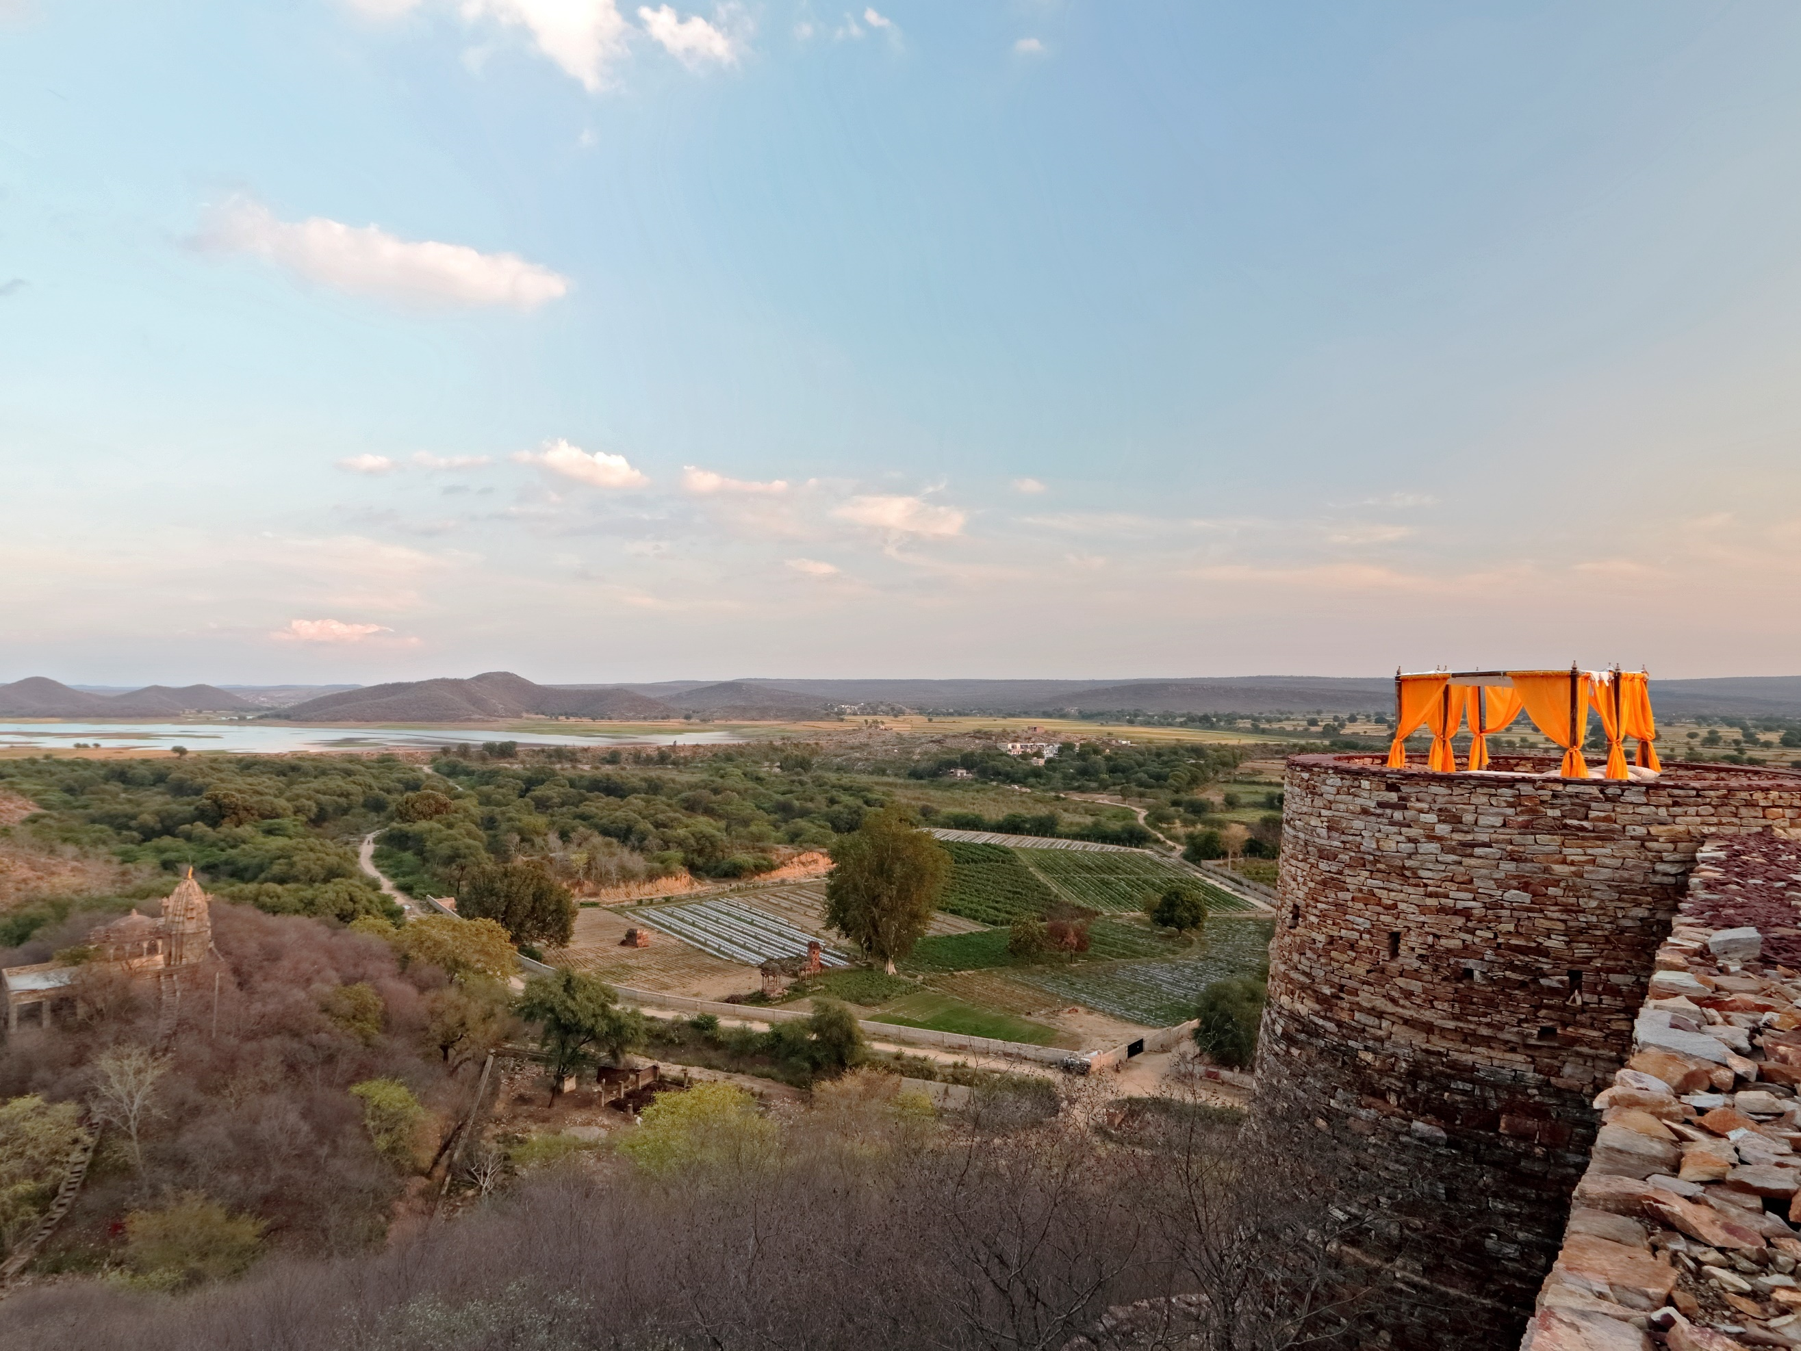

Slide 10
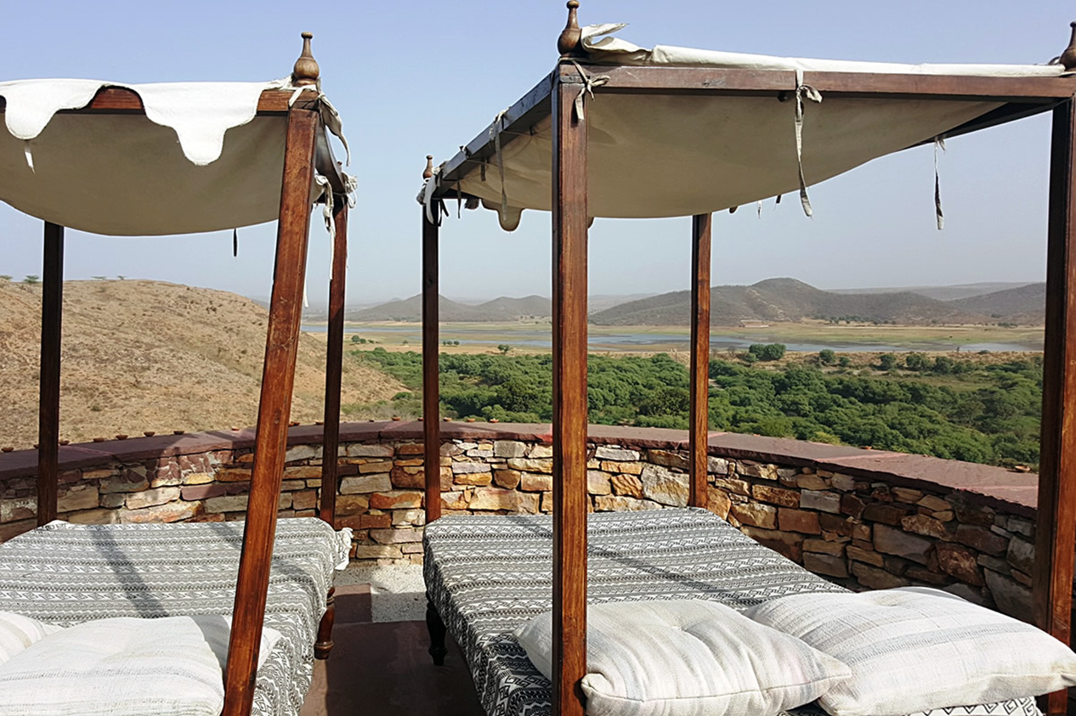

Slide 11
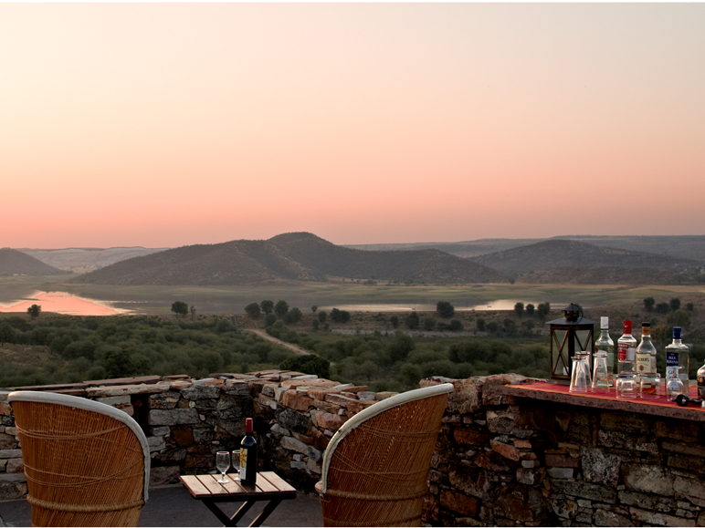

Slide 12
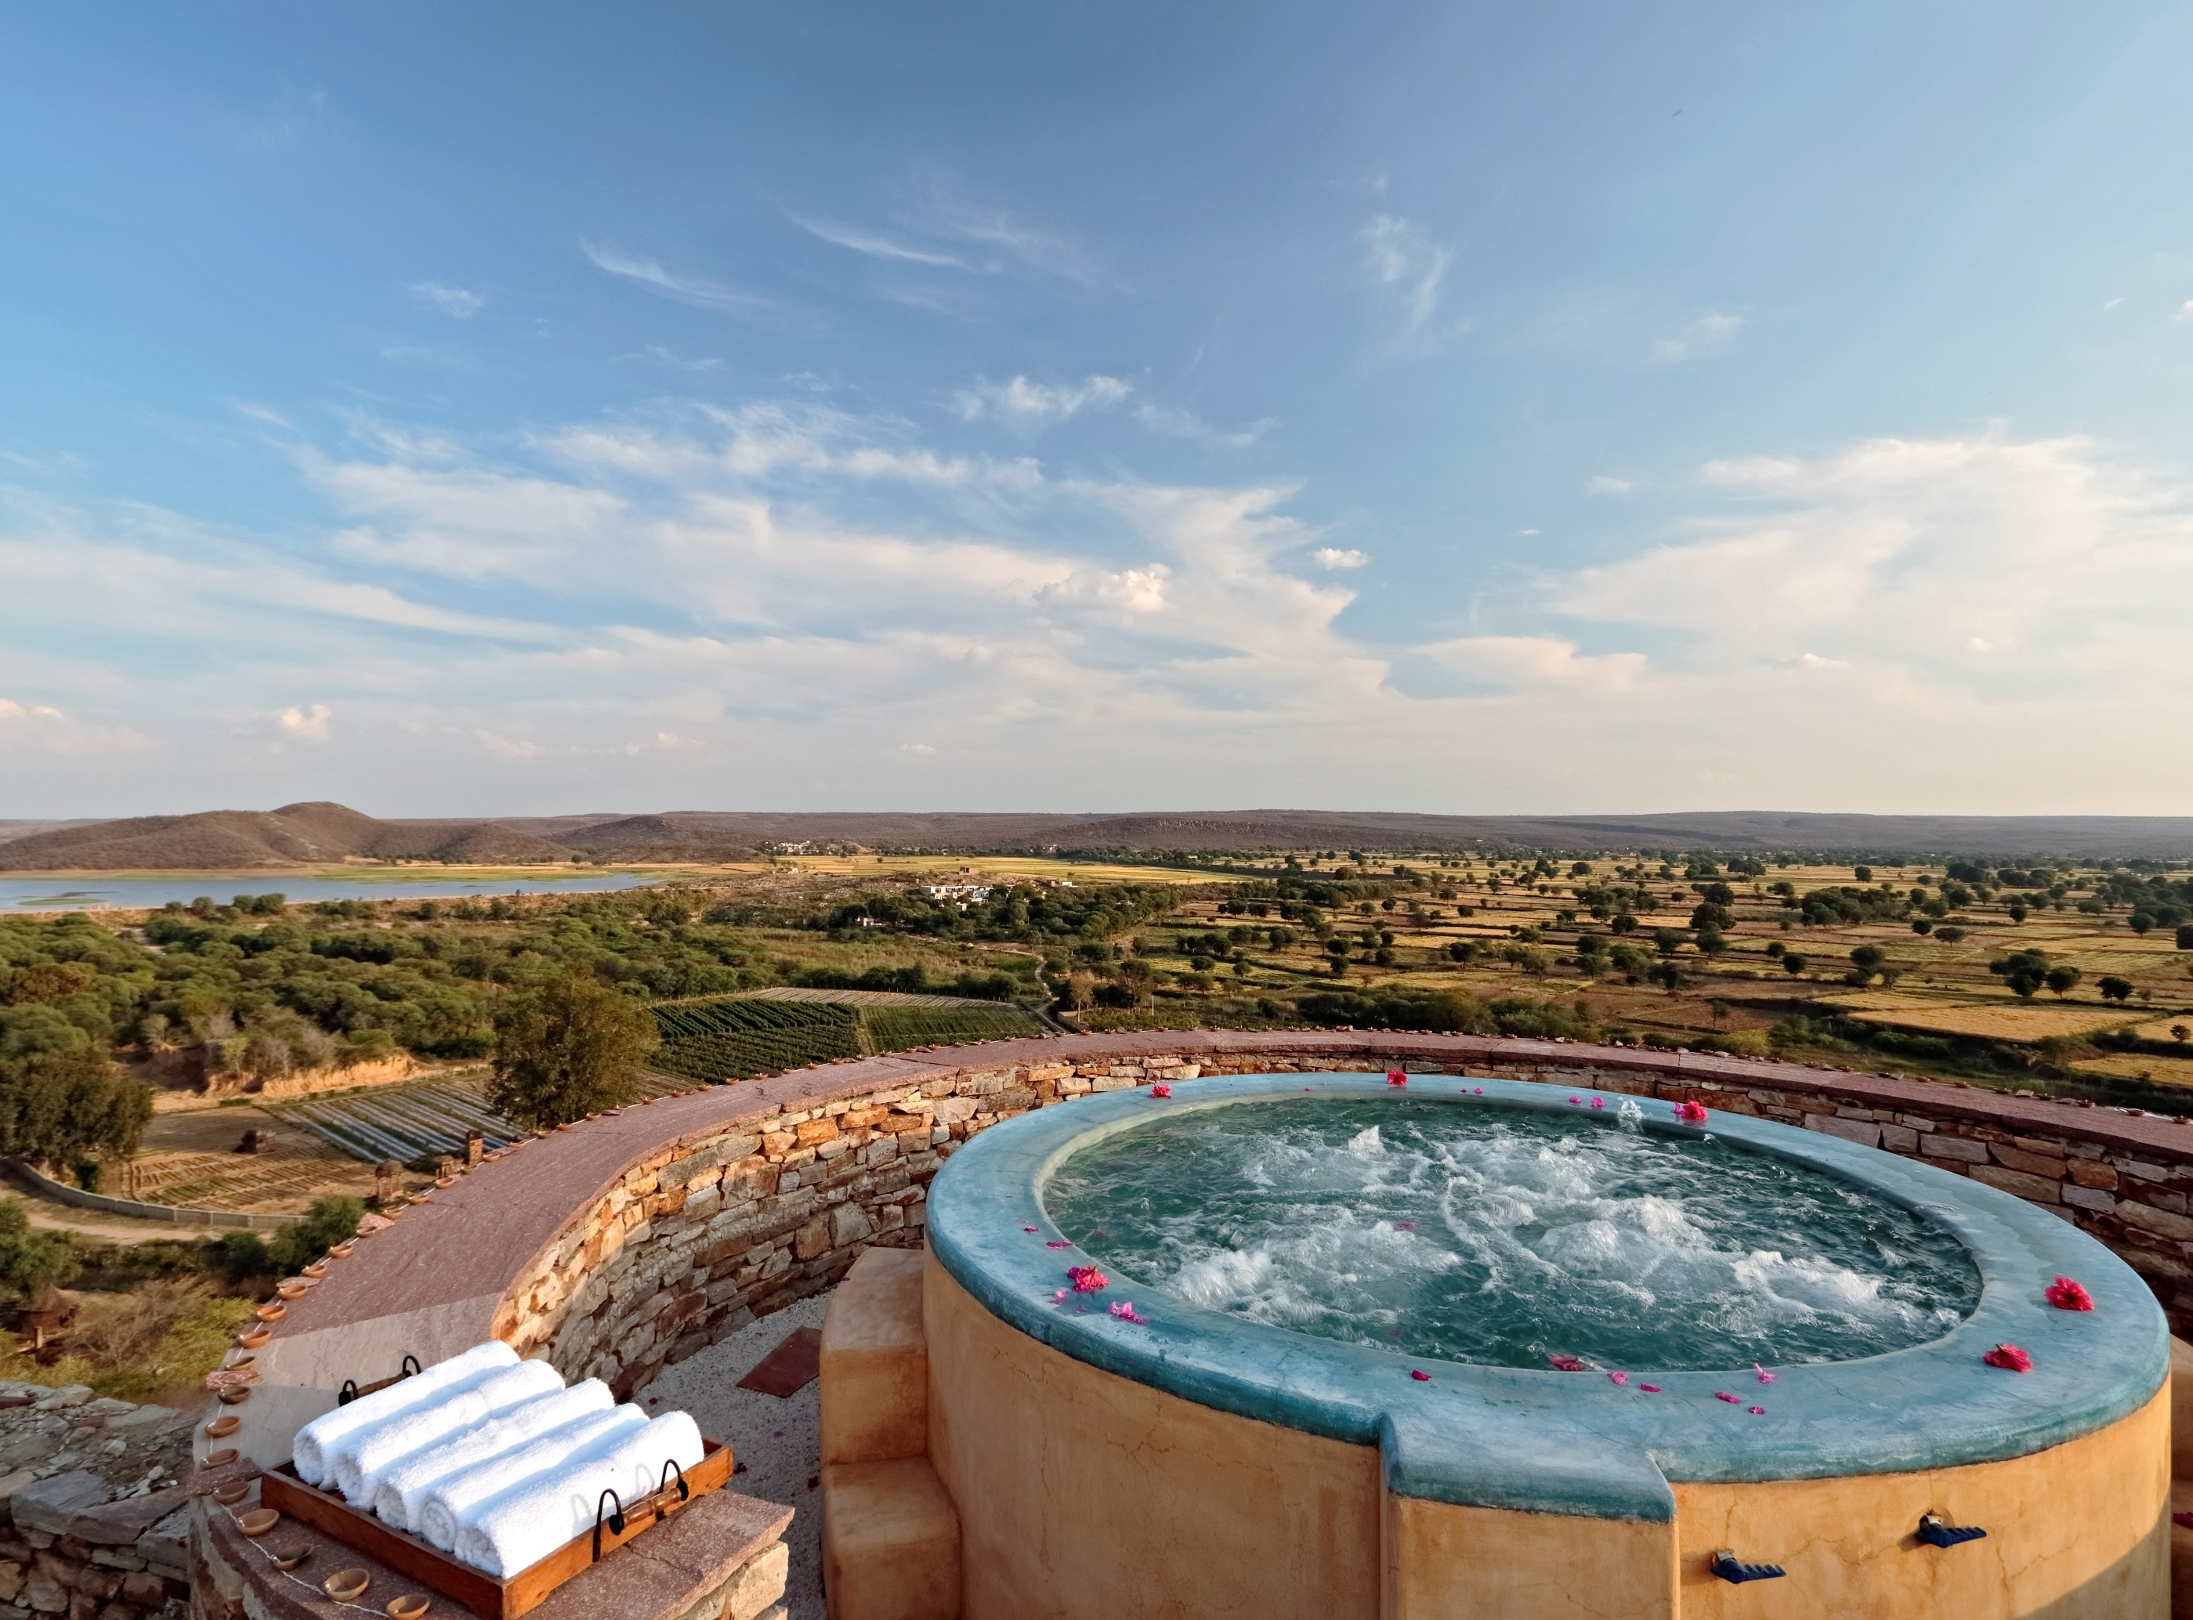

Slide 13
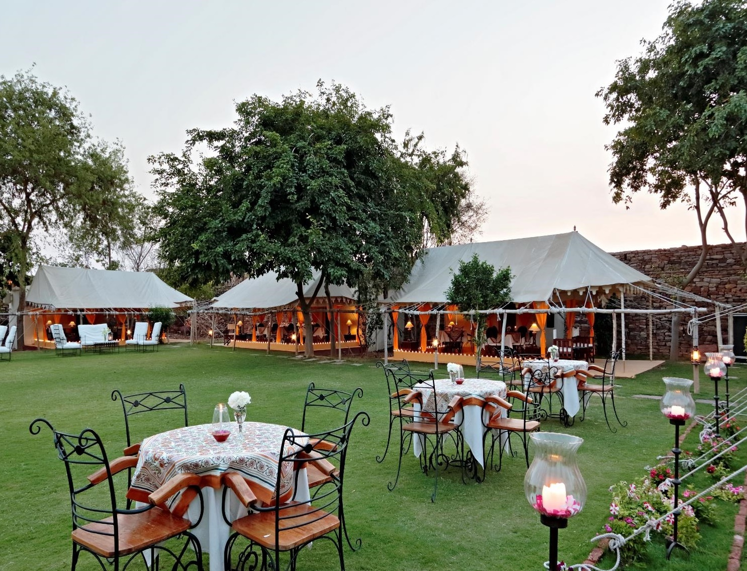

Slide 14
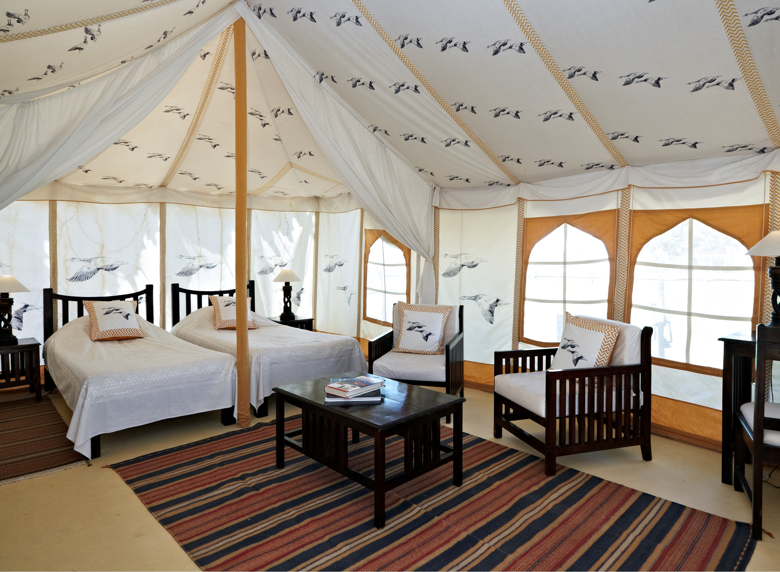
Luxury Tent

Slide 15
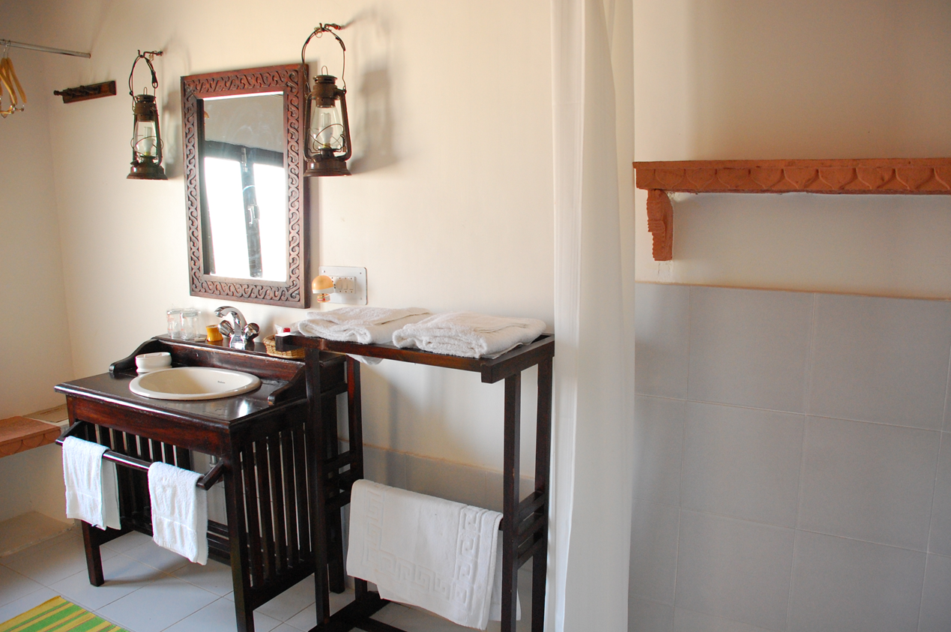
Luxury Tent en-suite Bathroom

Slide 16
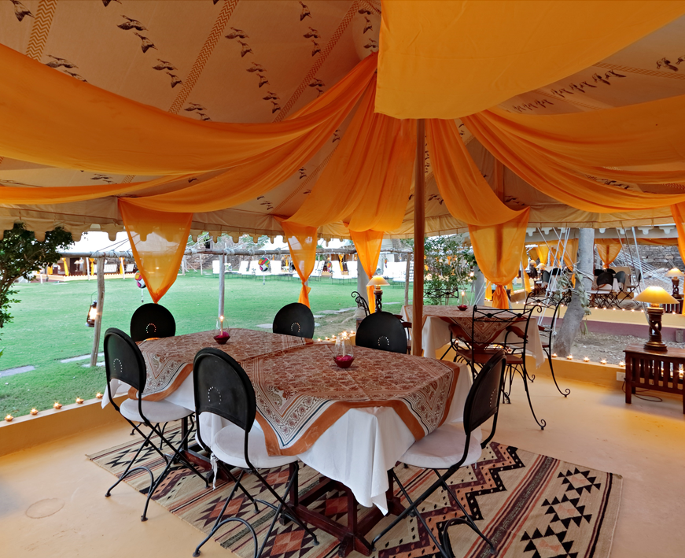

Slide 17
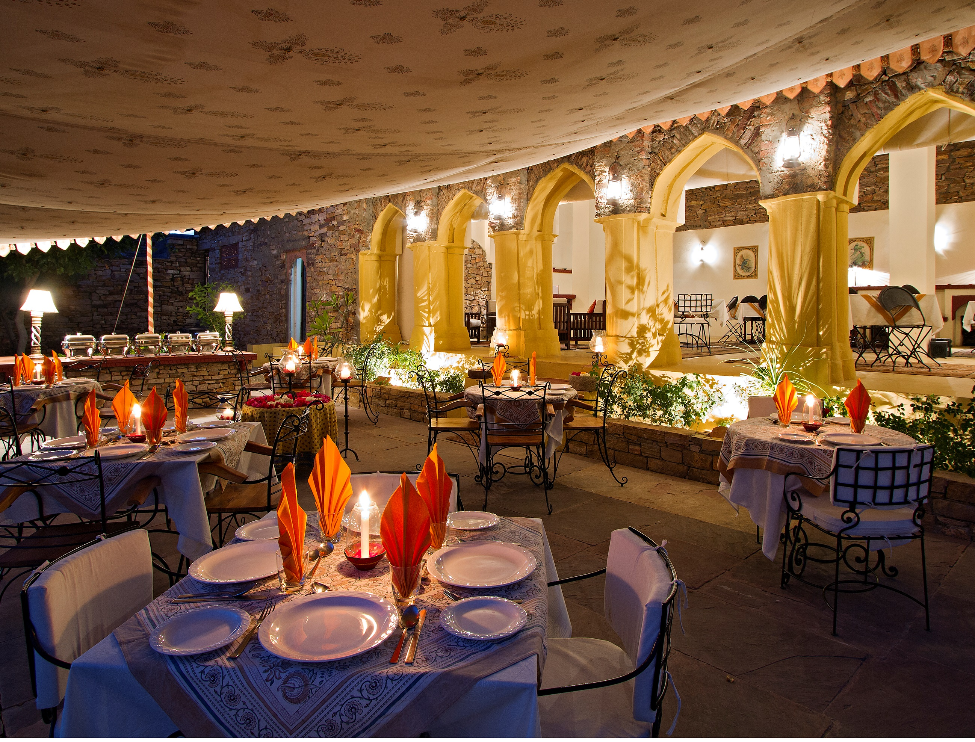

Slide 18
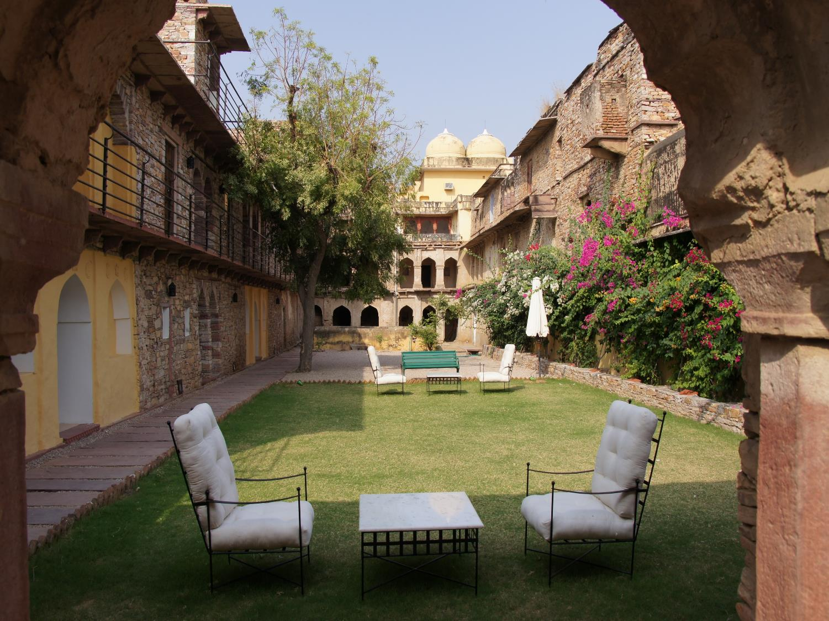

Slide 19
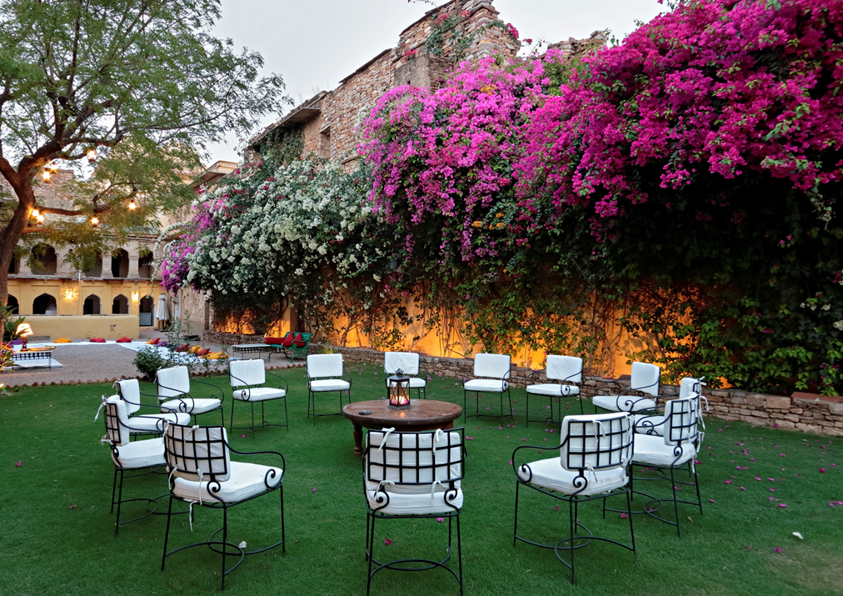

Slide 20
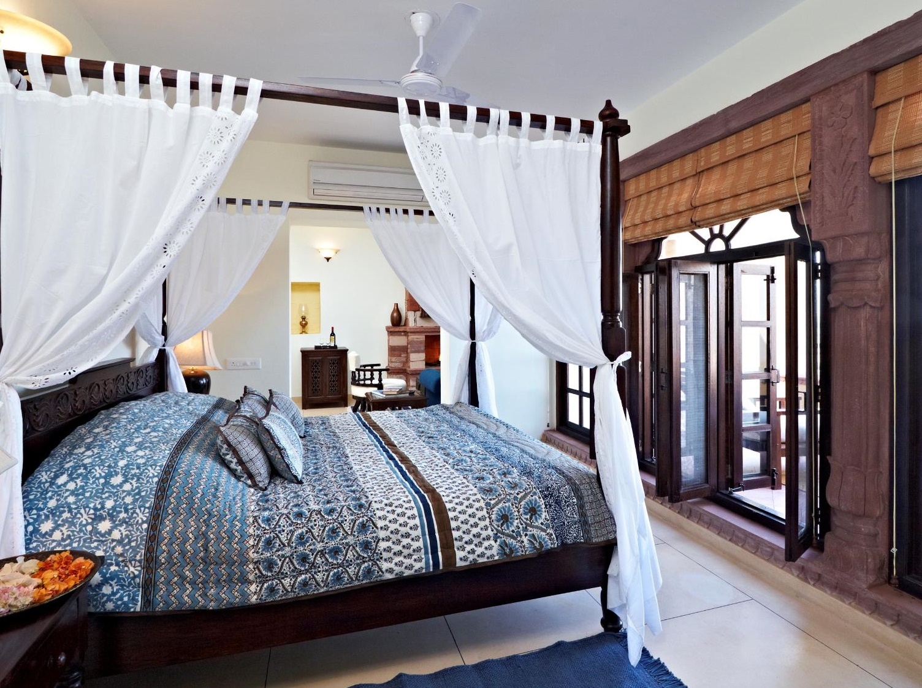
Luxury Suite

Slide 21
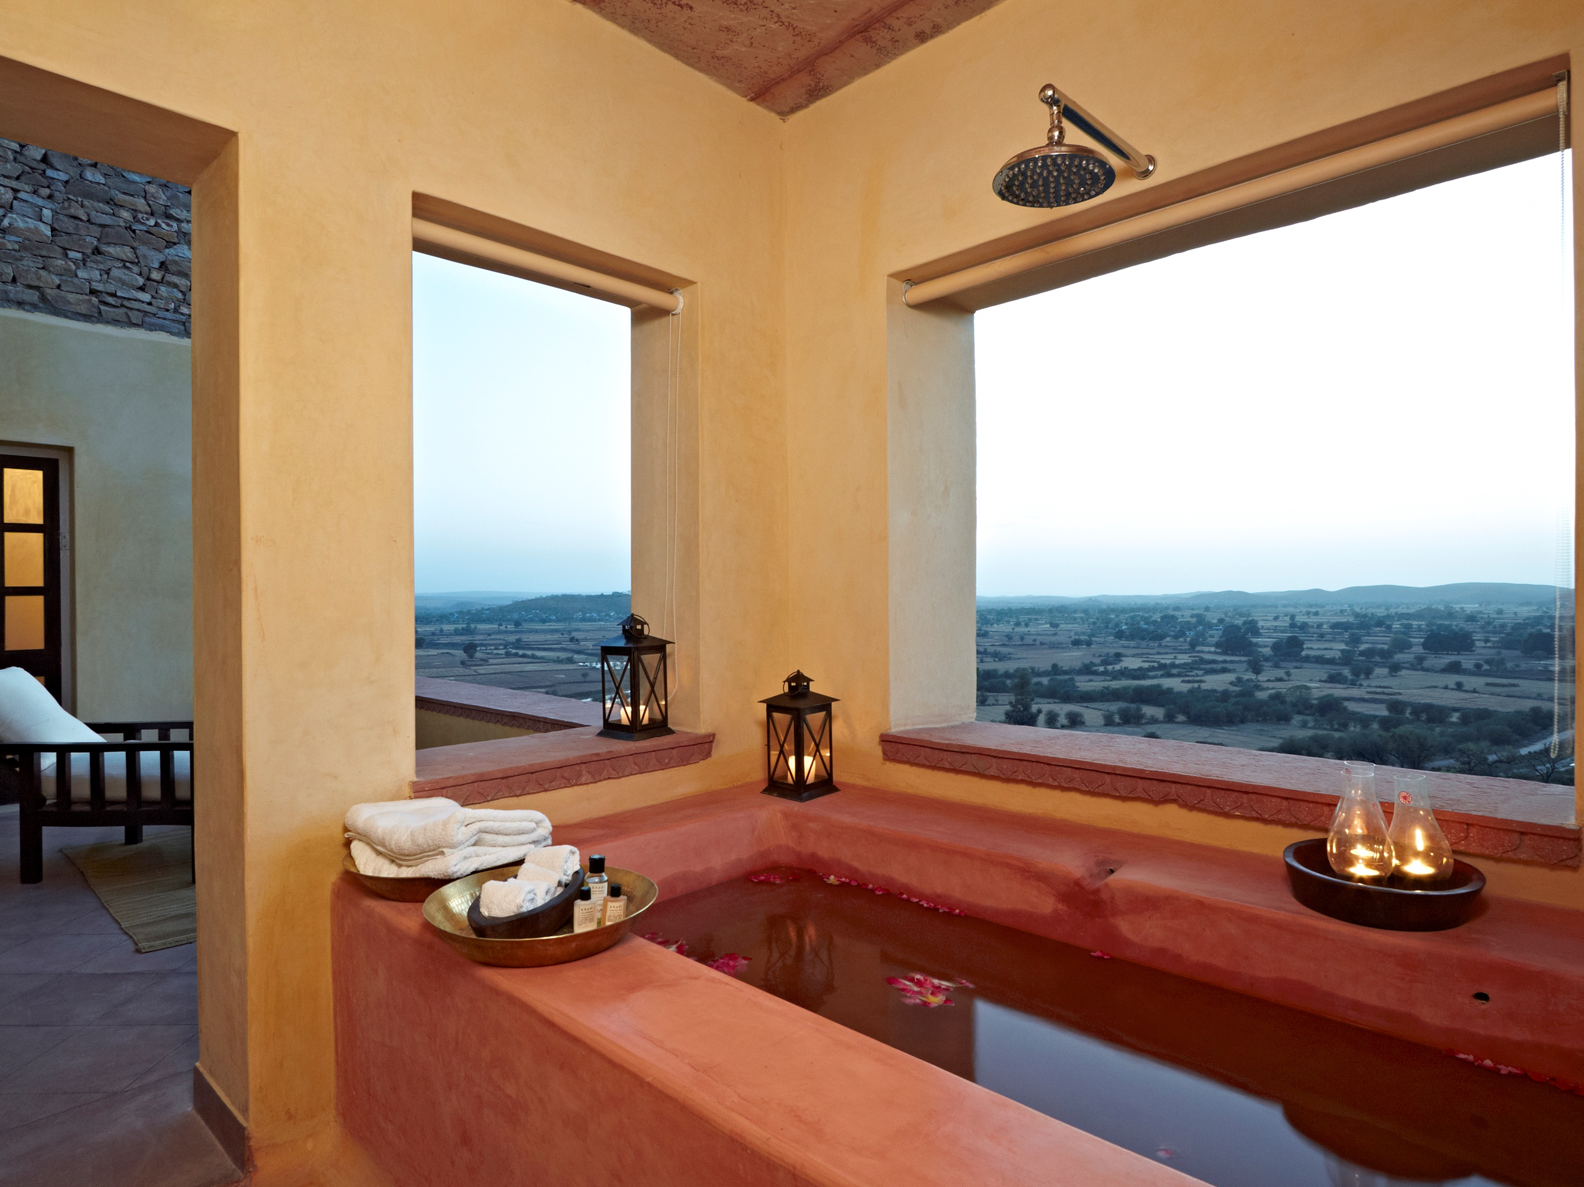
Luxury Suite

Slide 22
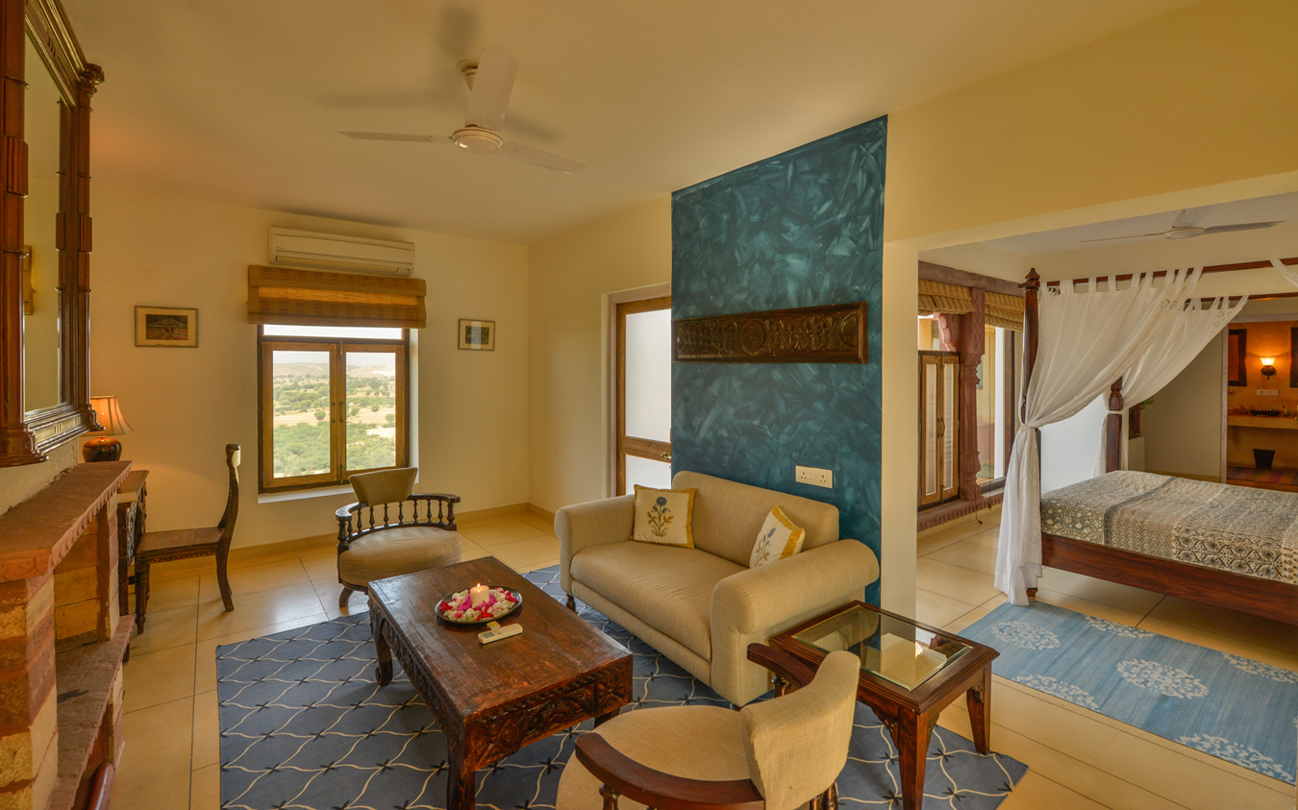
Luxury Suite

Slide 23
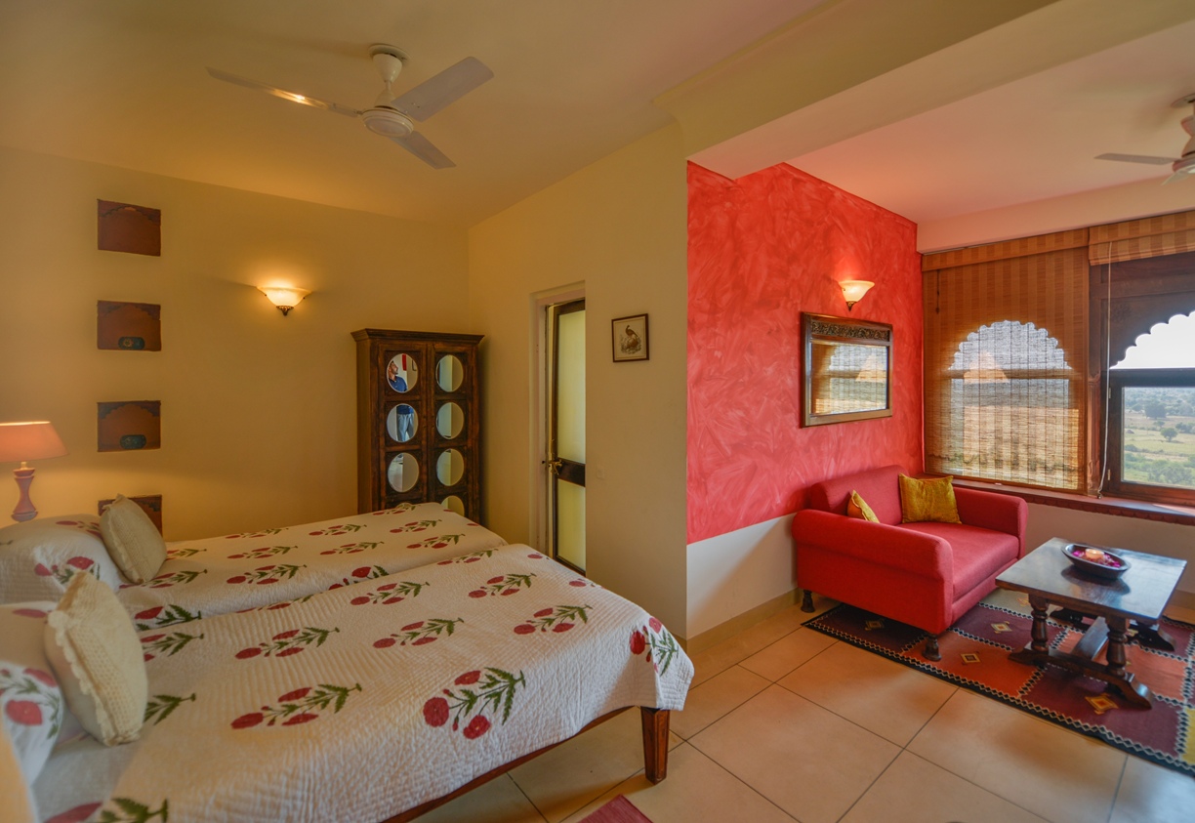
Deluxe Room

Slide 24
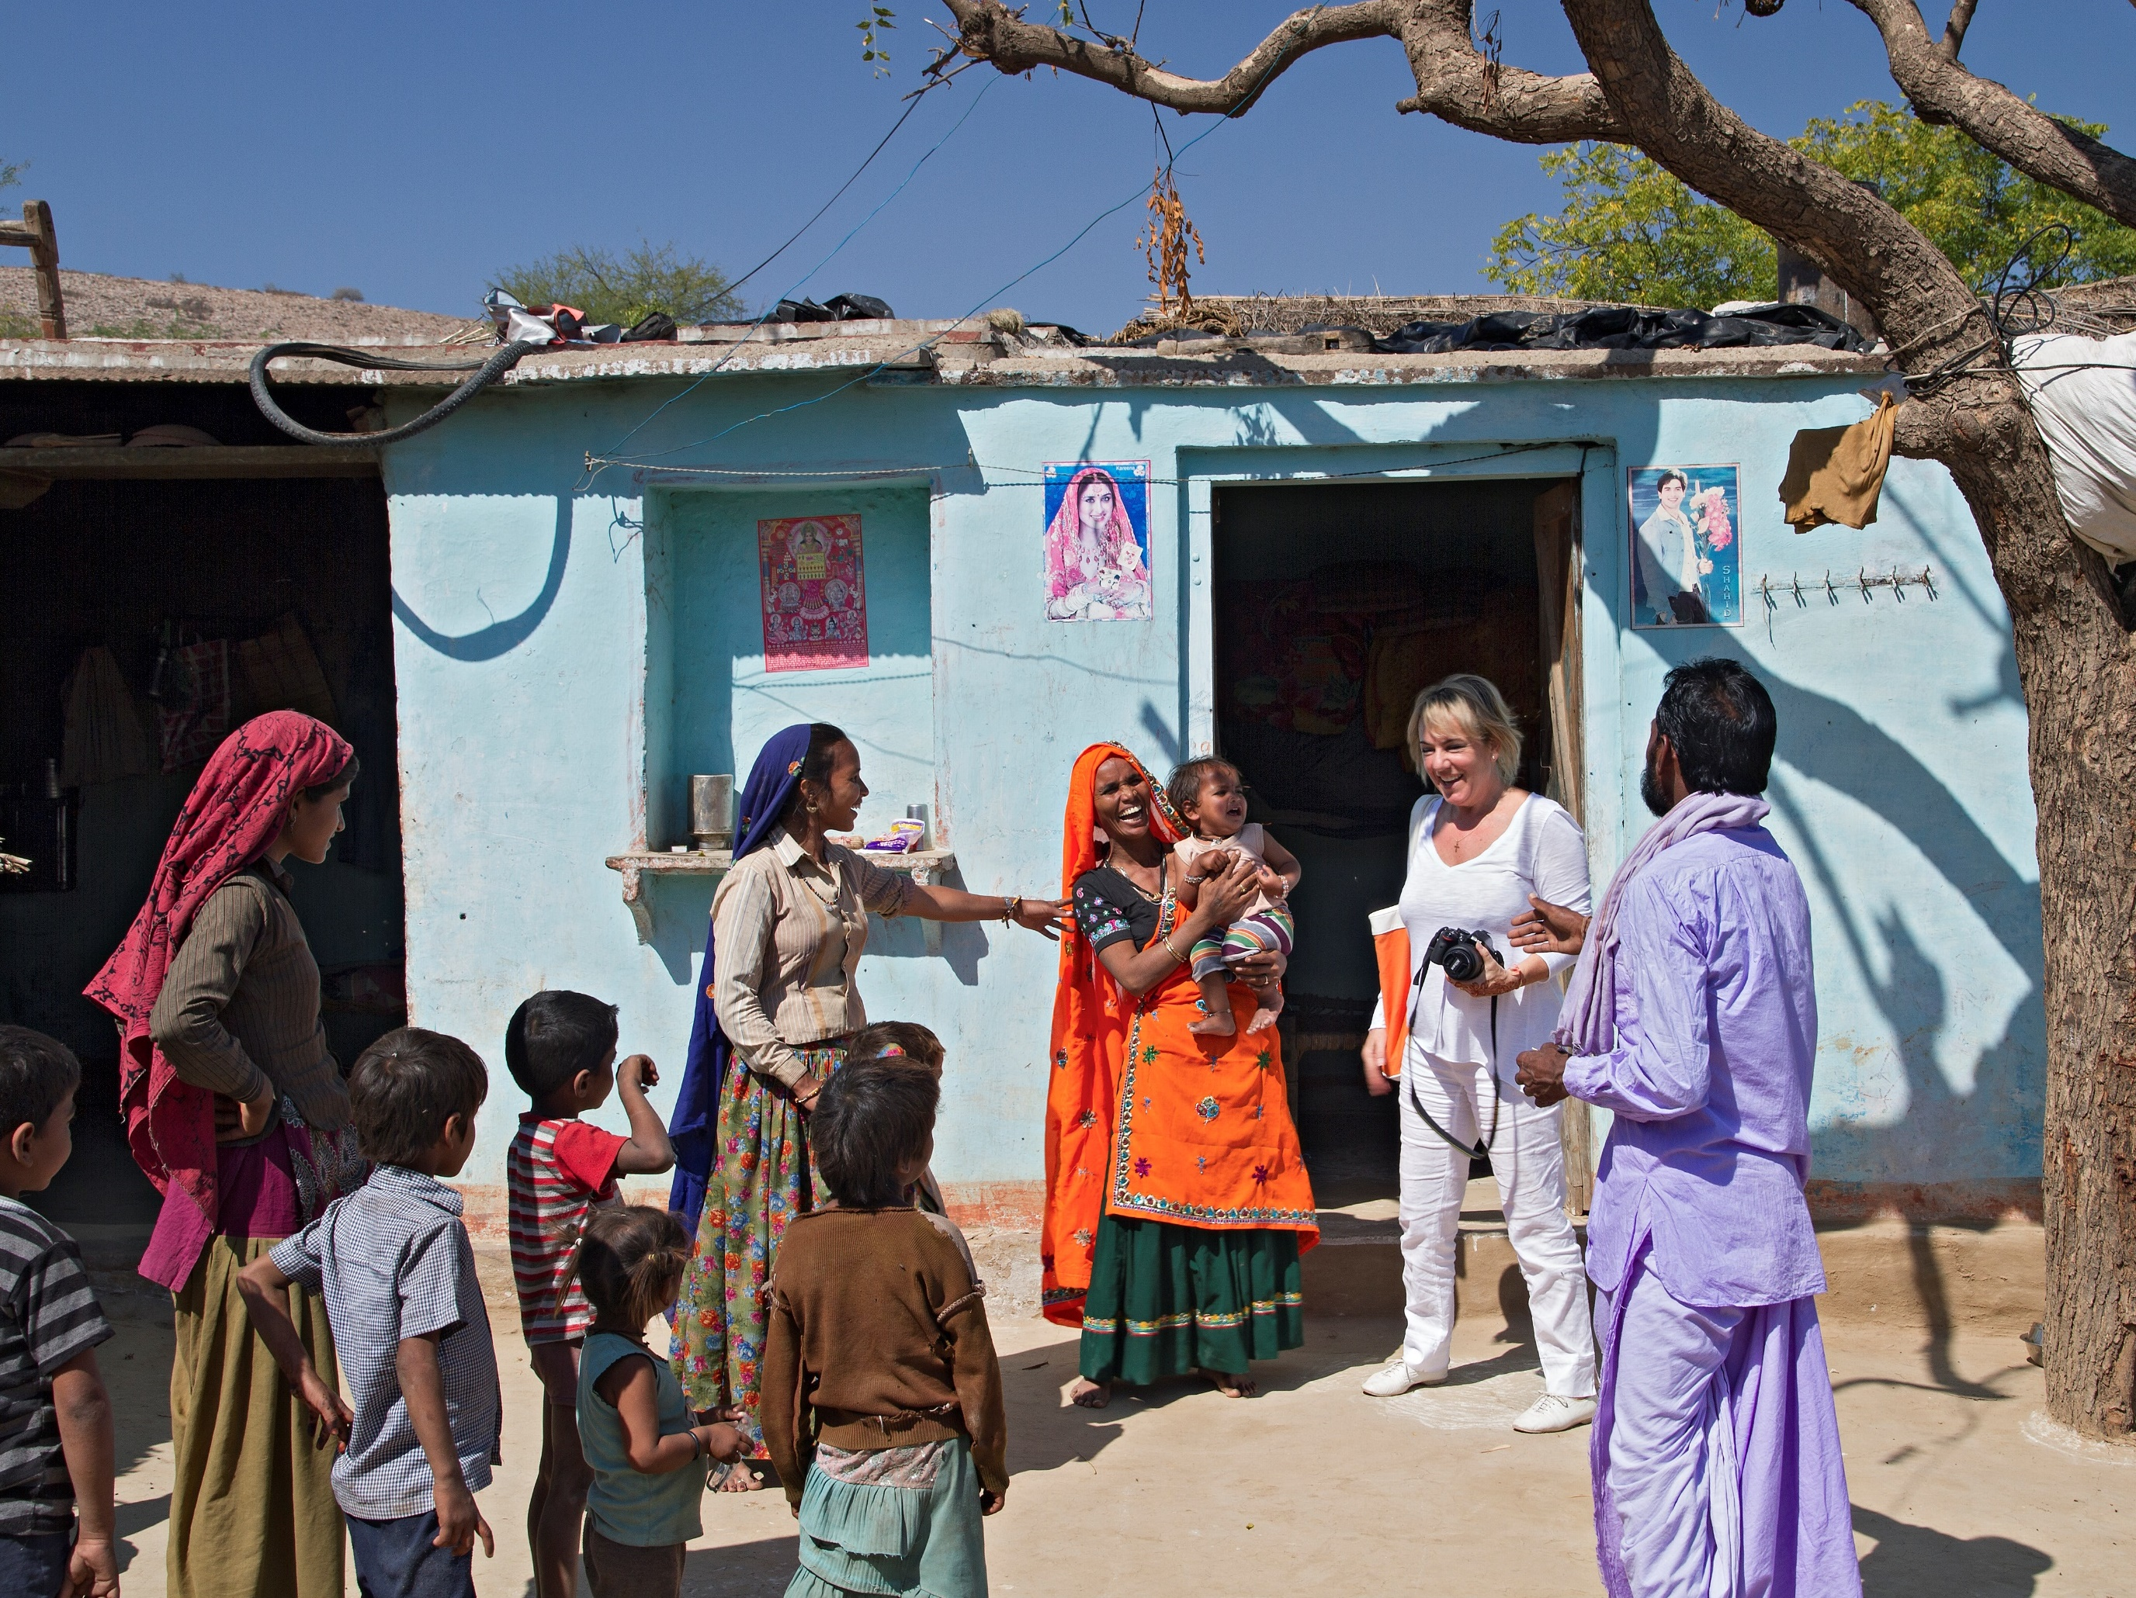
Village Walk

Slide 25
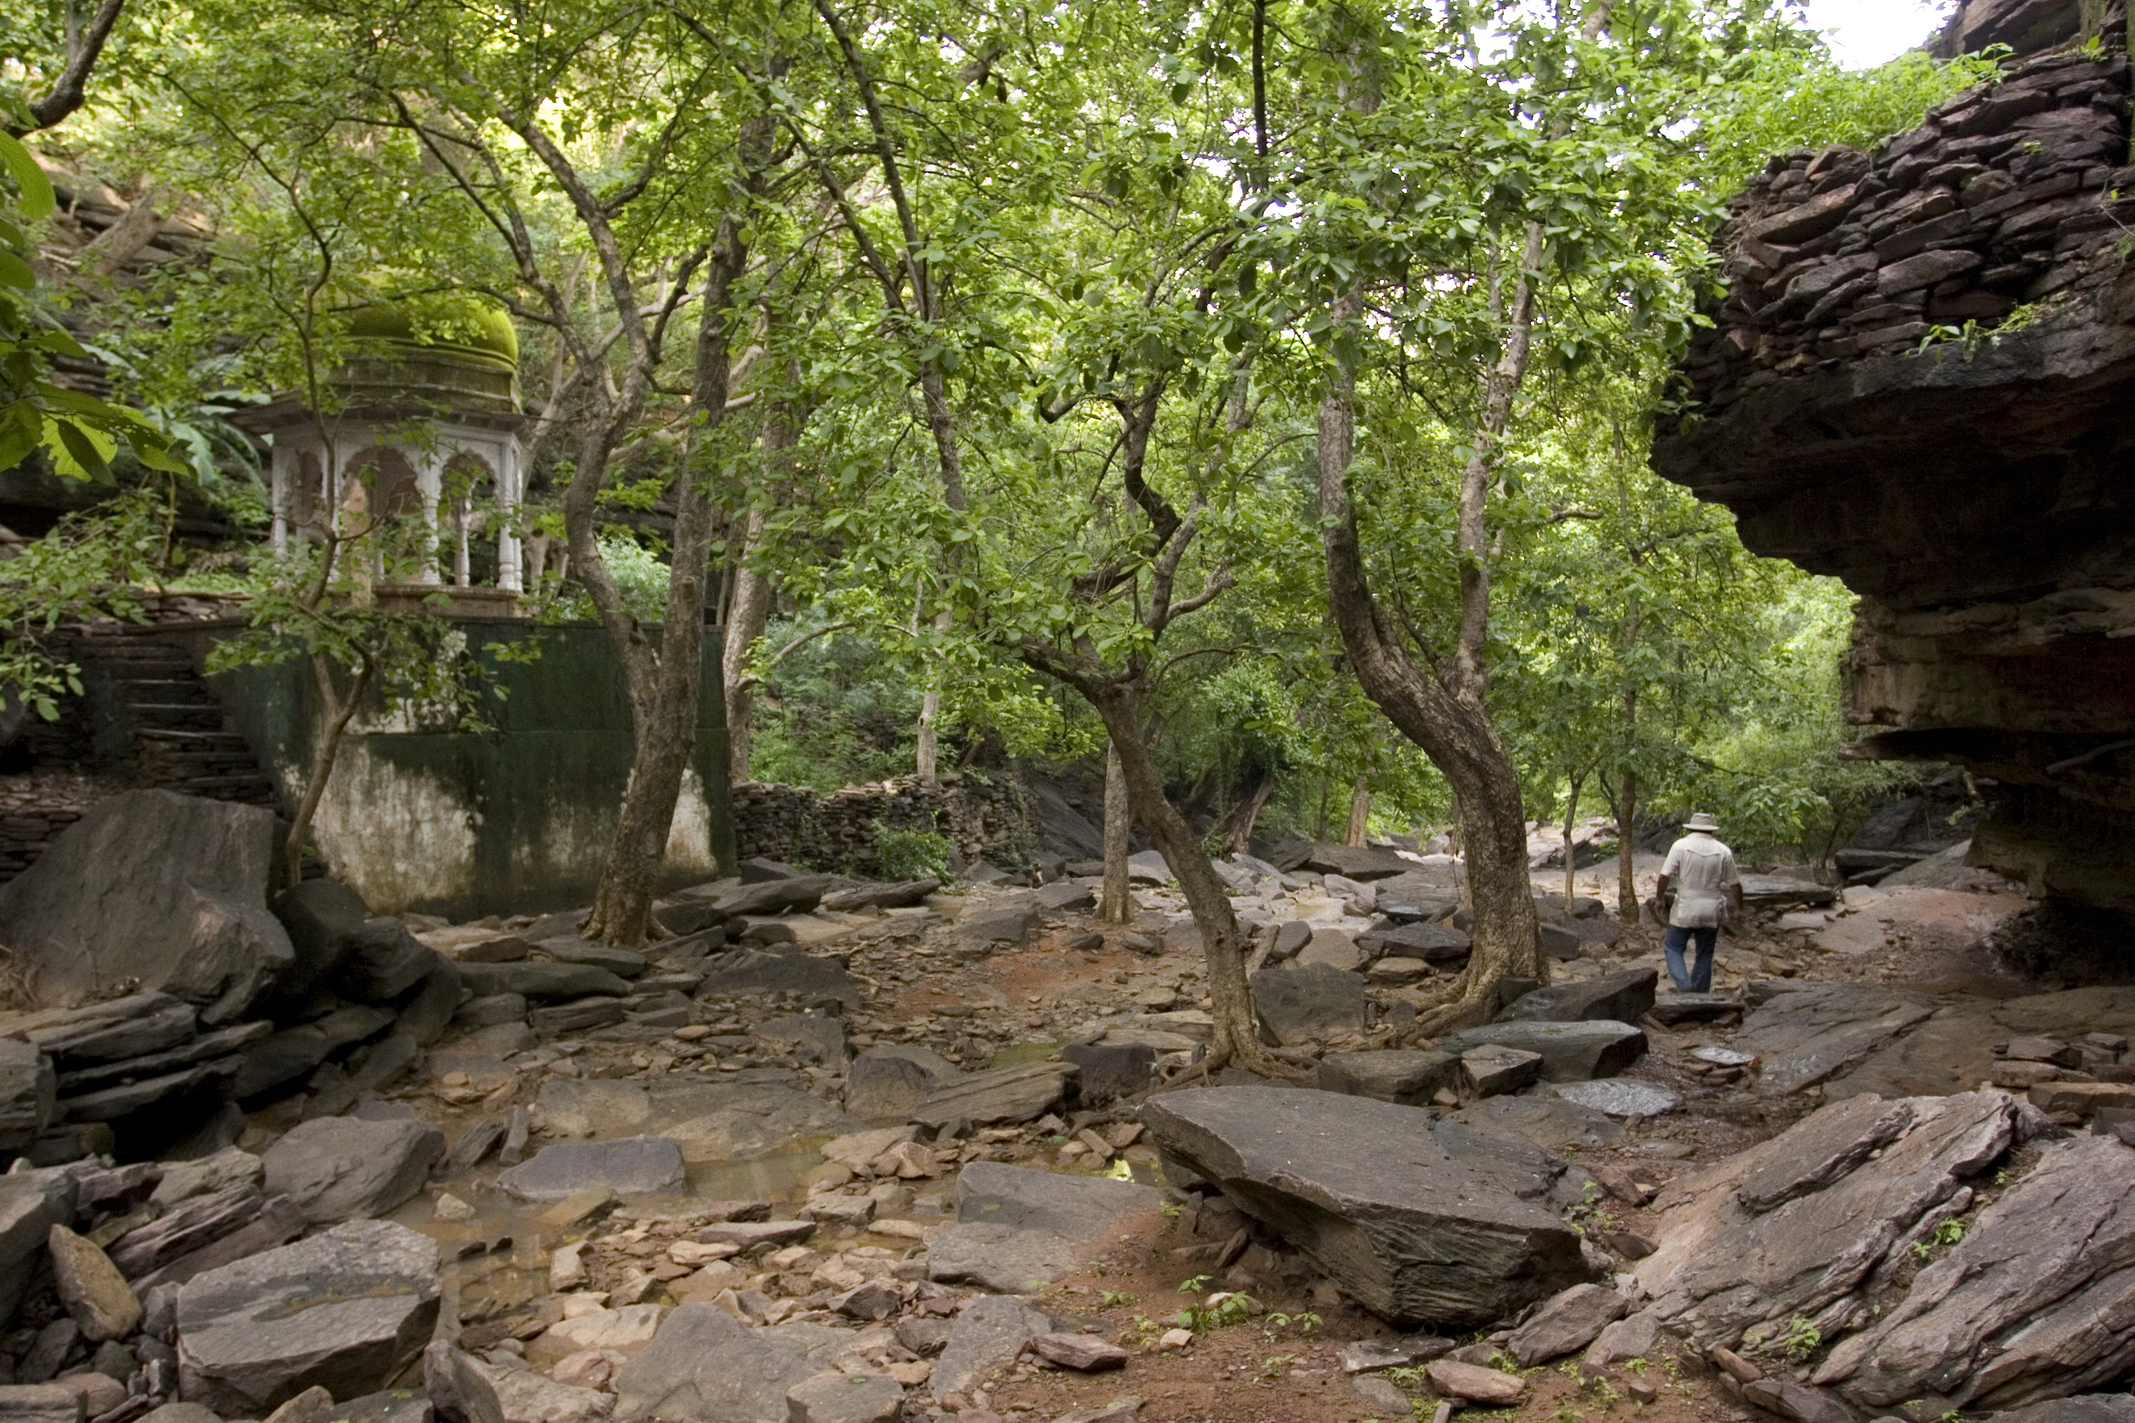

Slide 26
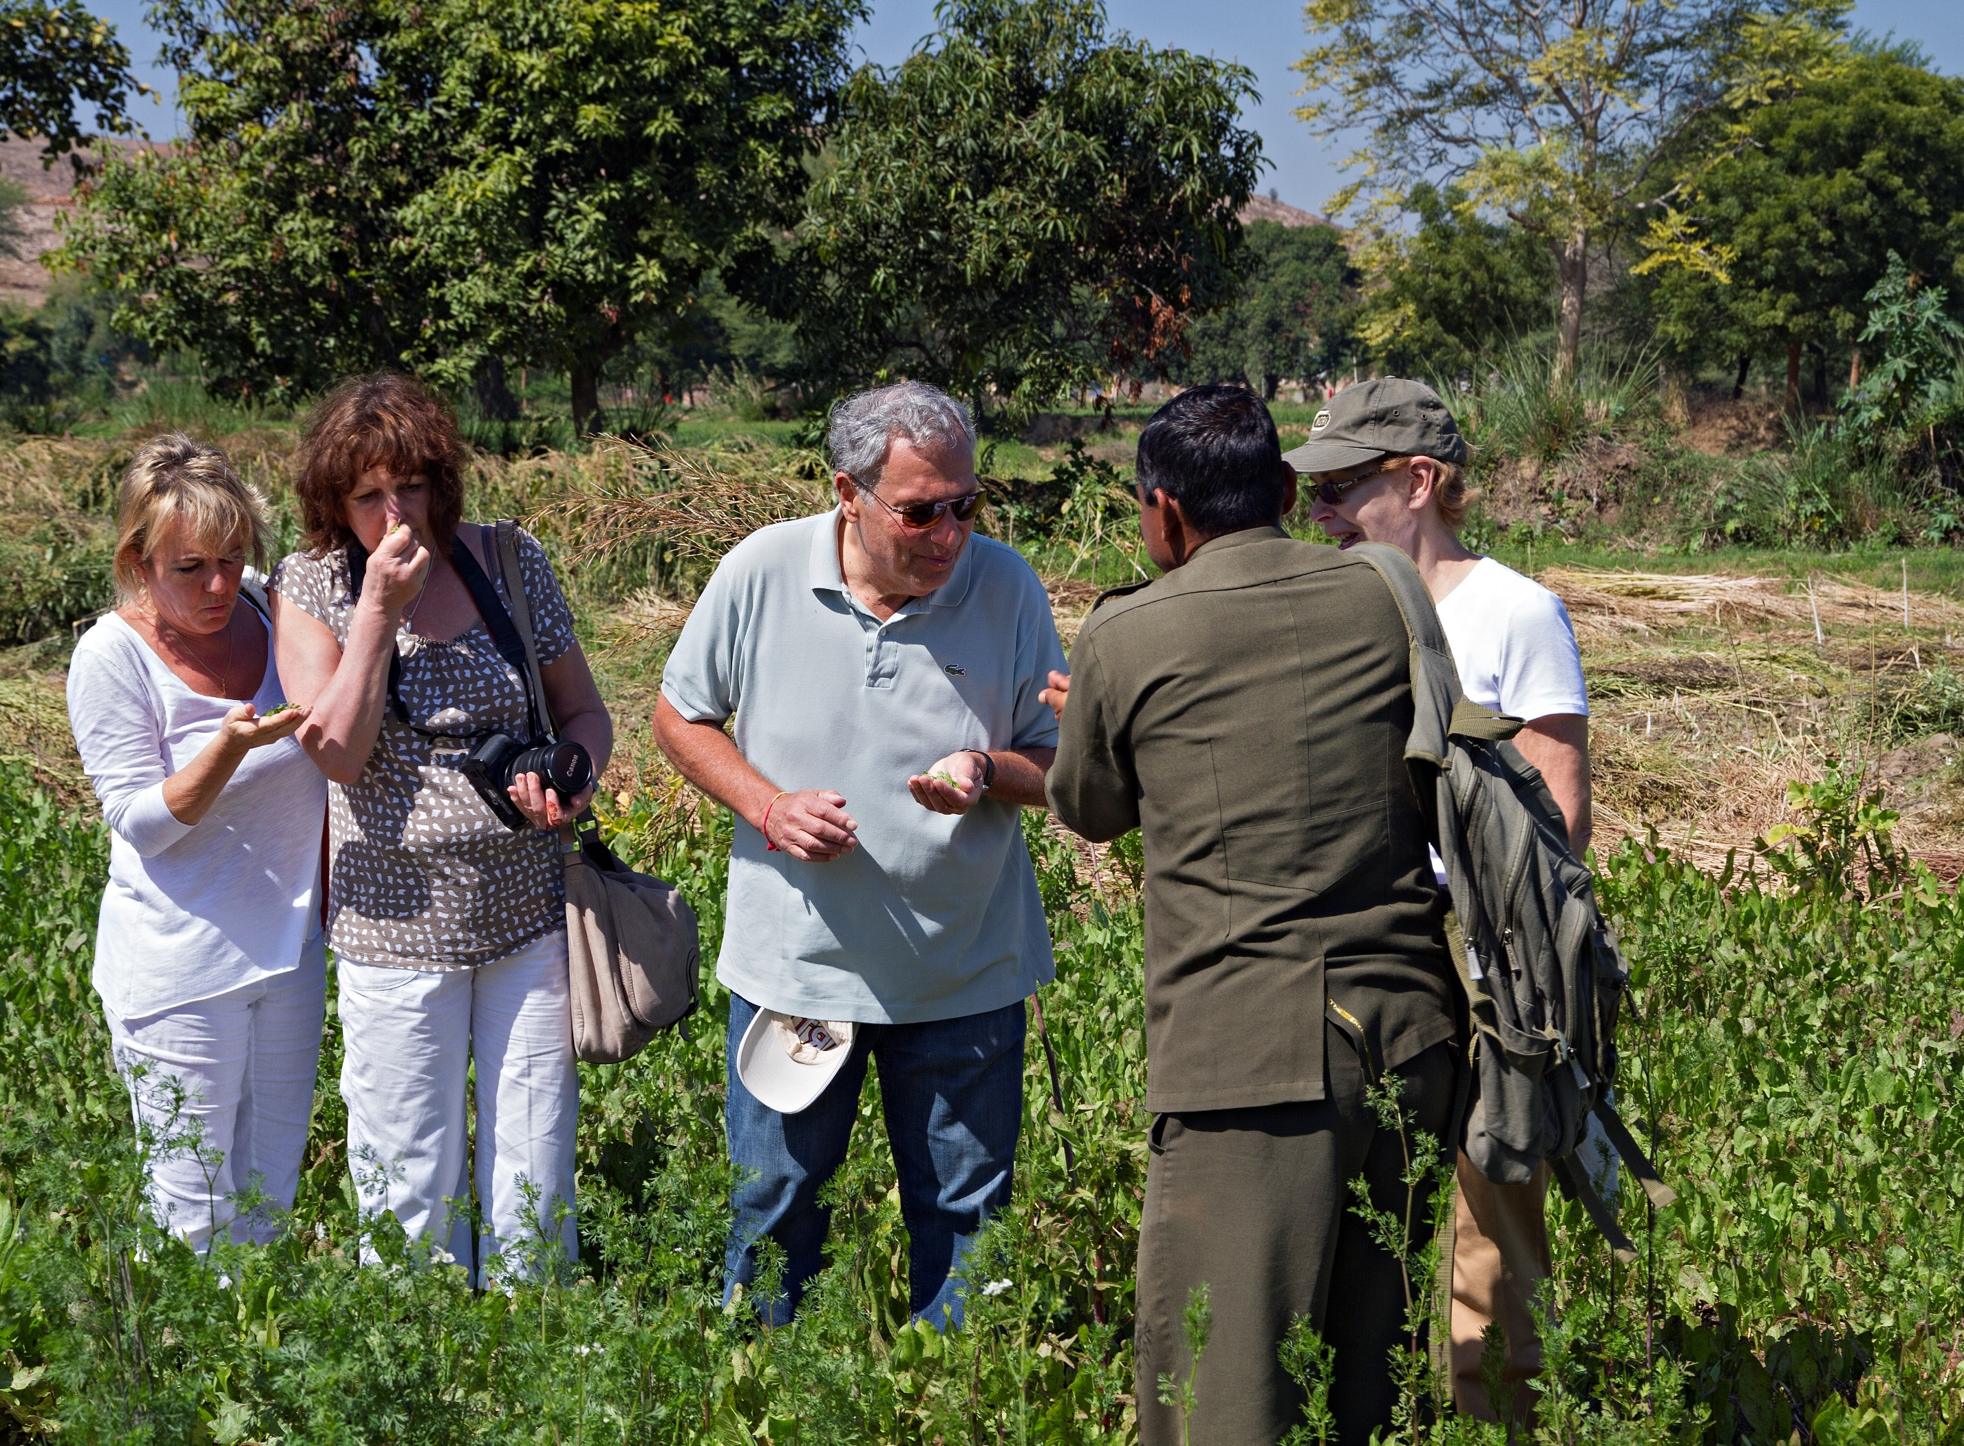
Farm visit

Slide 27
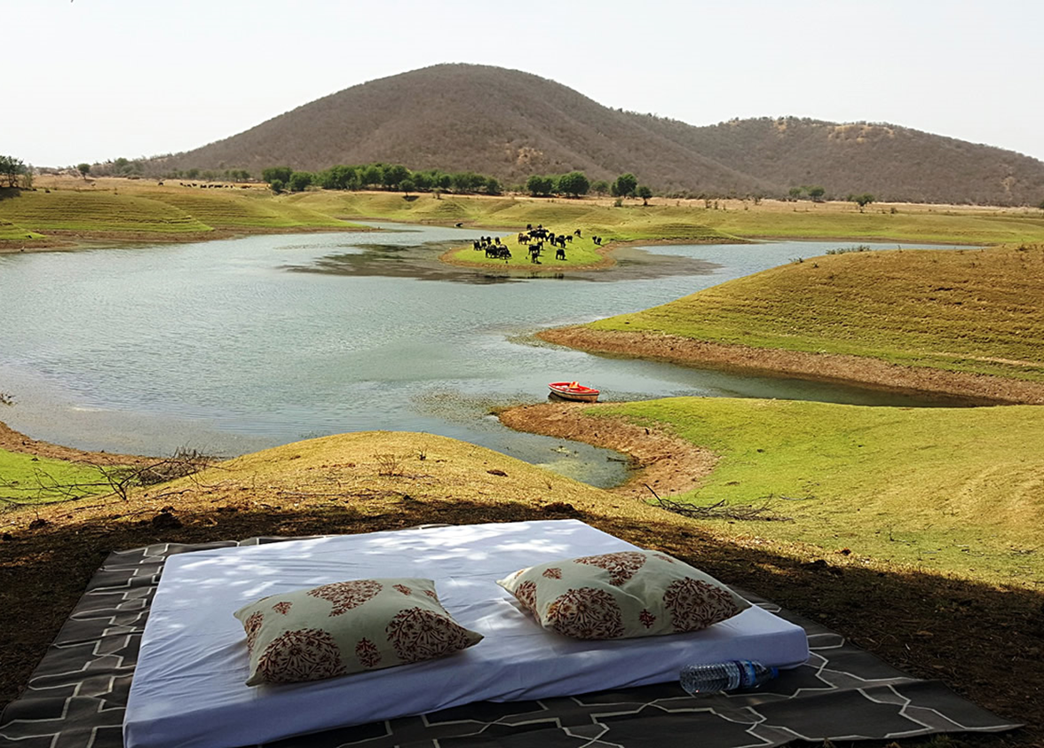
Lakeside Picnics

Slide 28
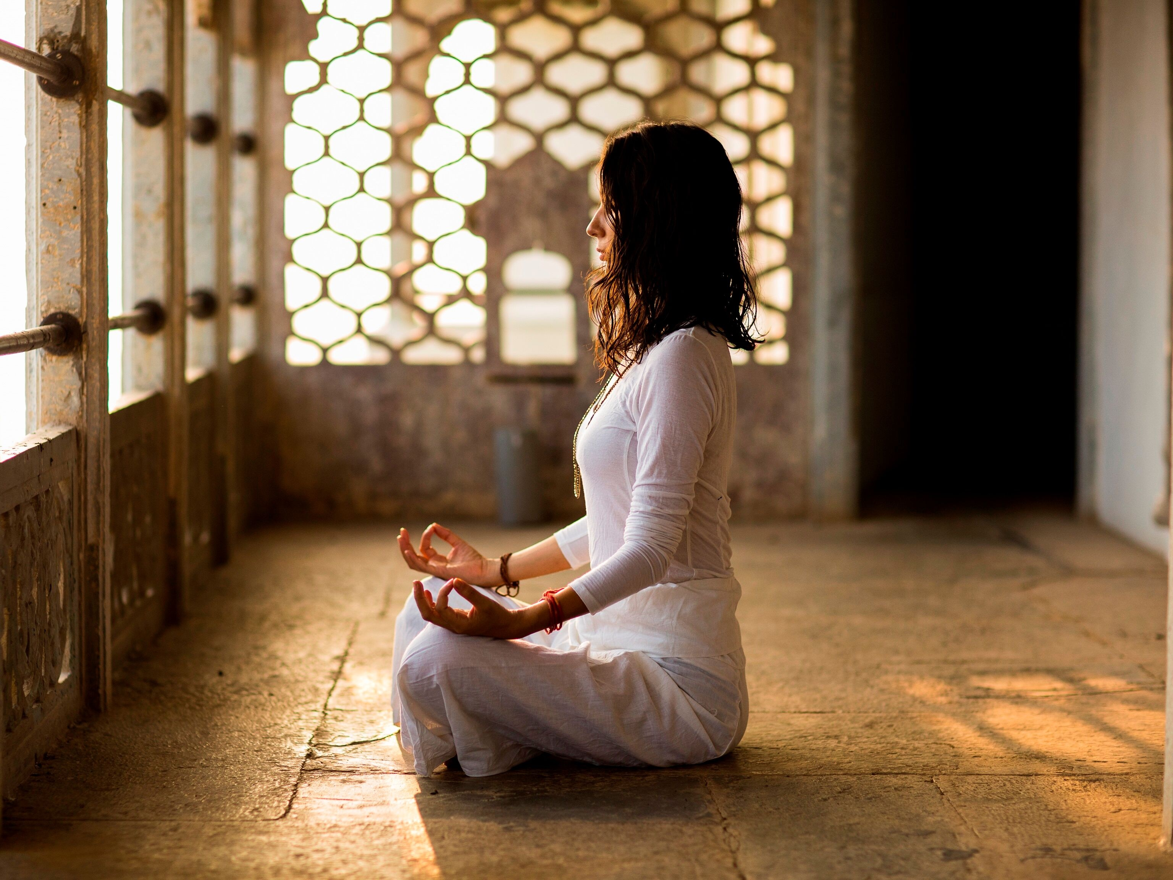
Yoga on Fort ramparts

Slide 29
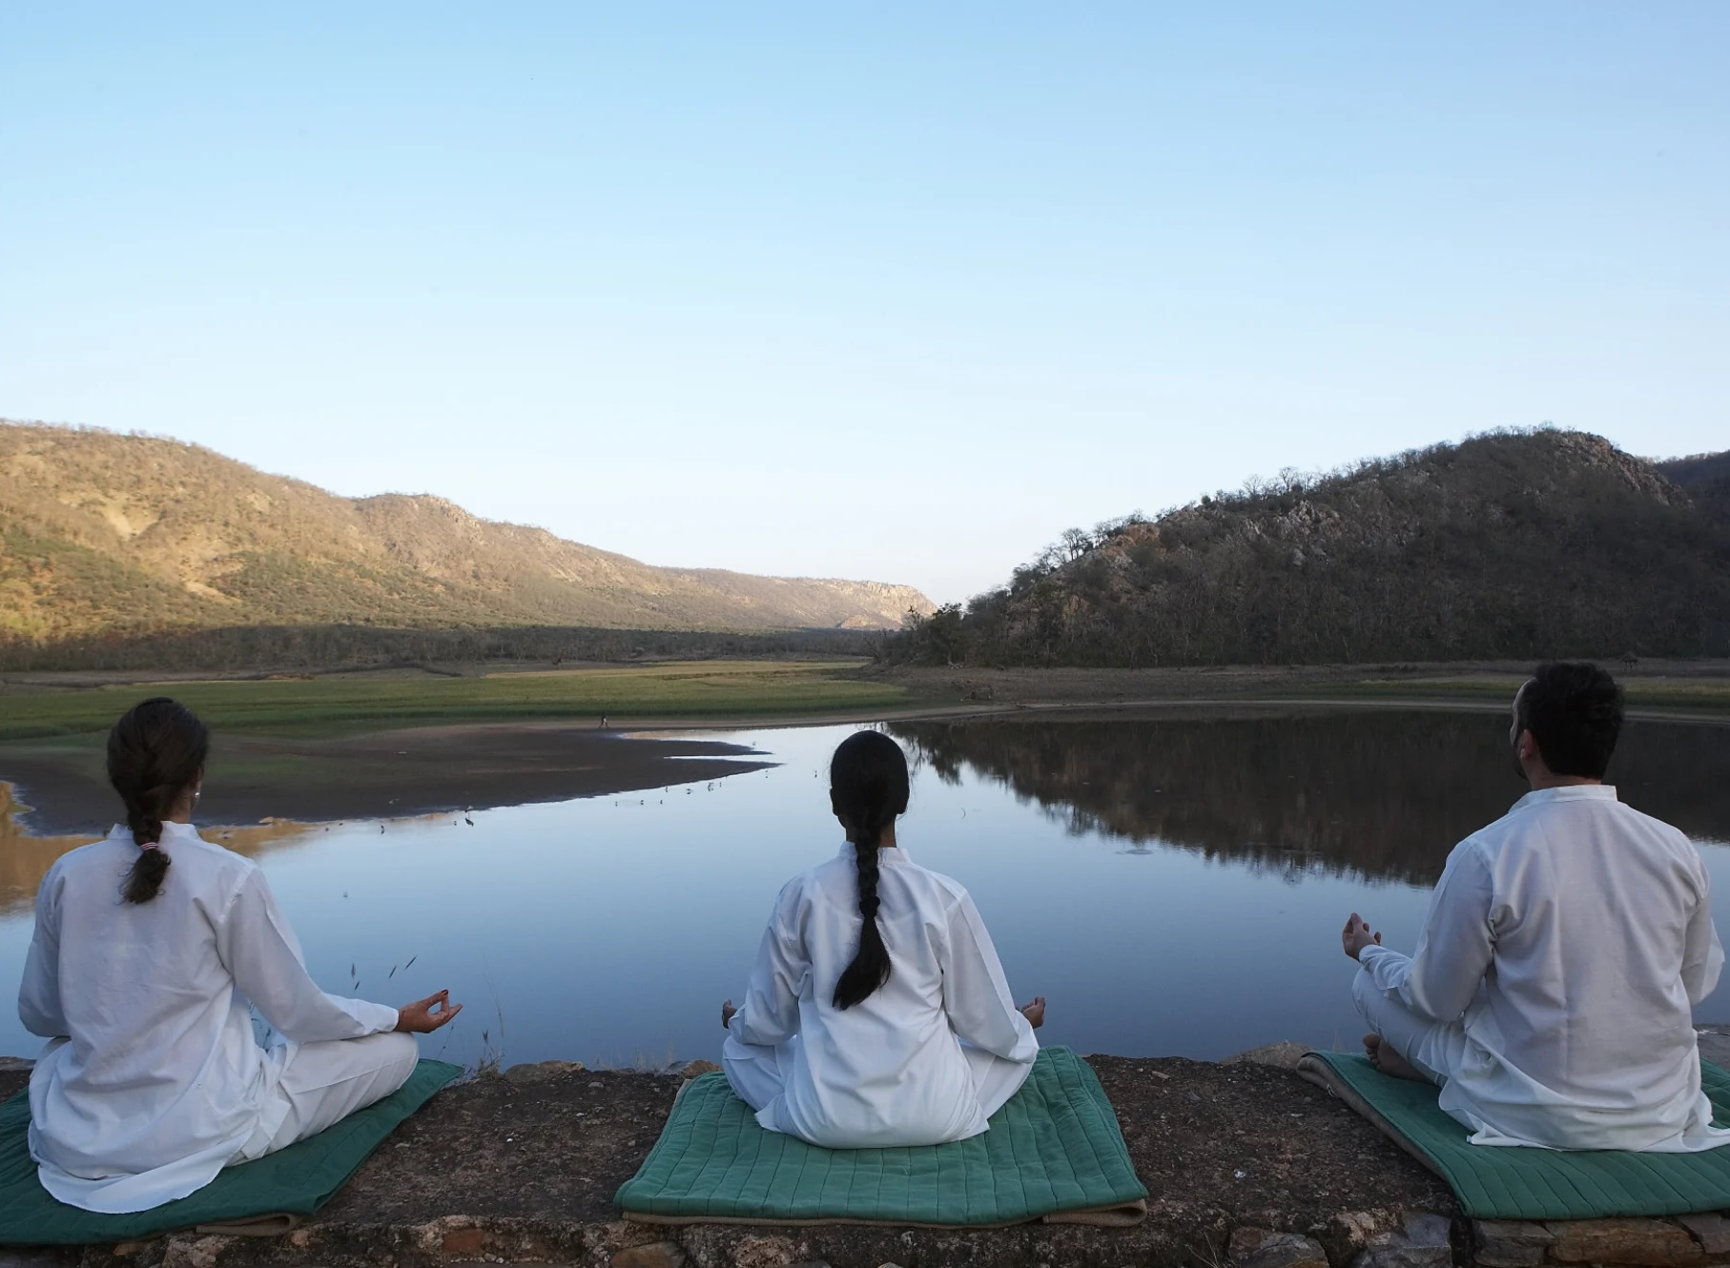
Yoga by the Lake

Slide 30
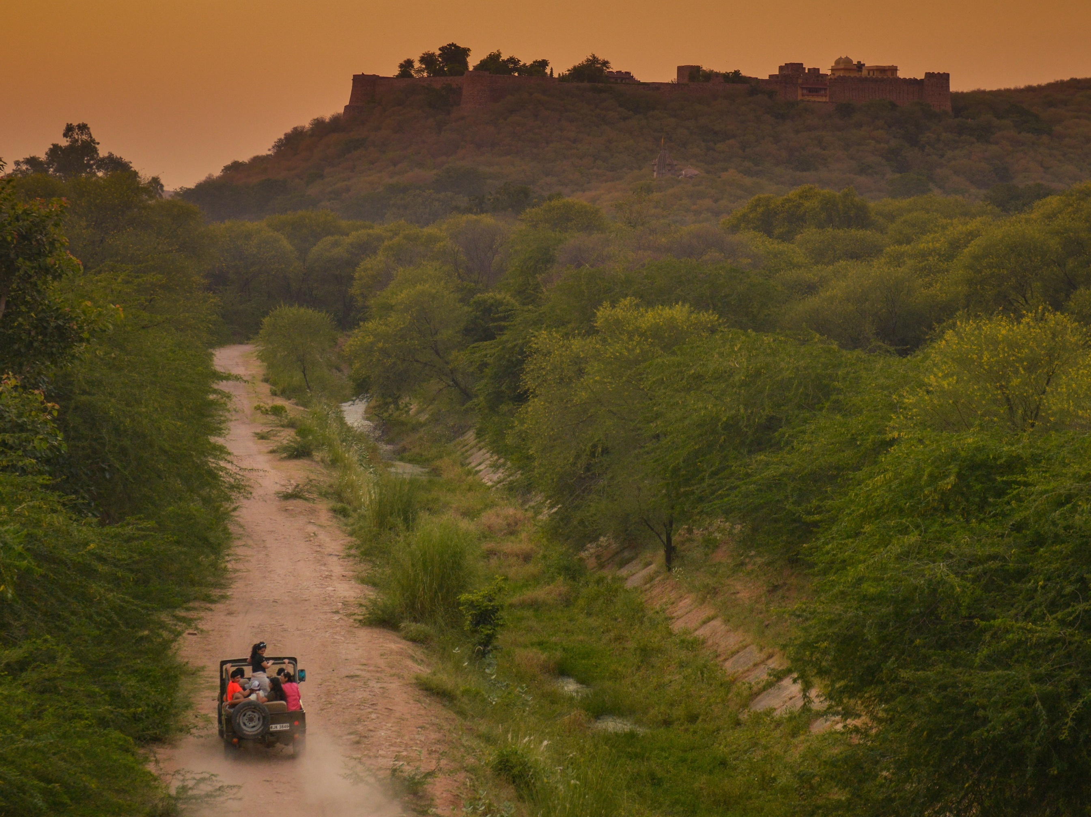
Night Safari

Slide 31
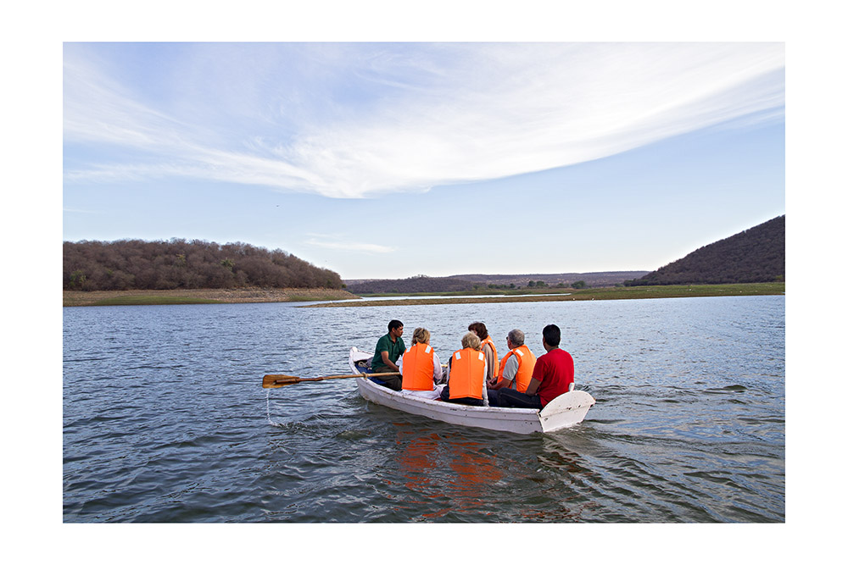
Boating on Lake

Slide 32
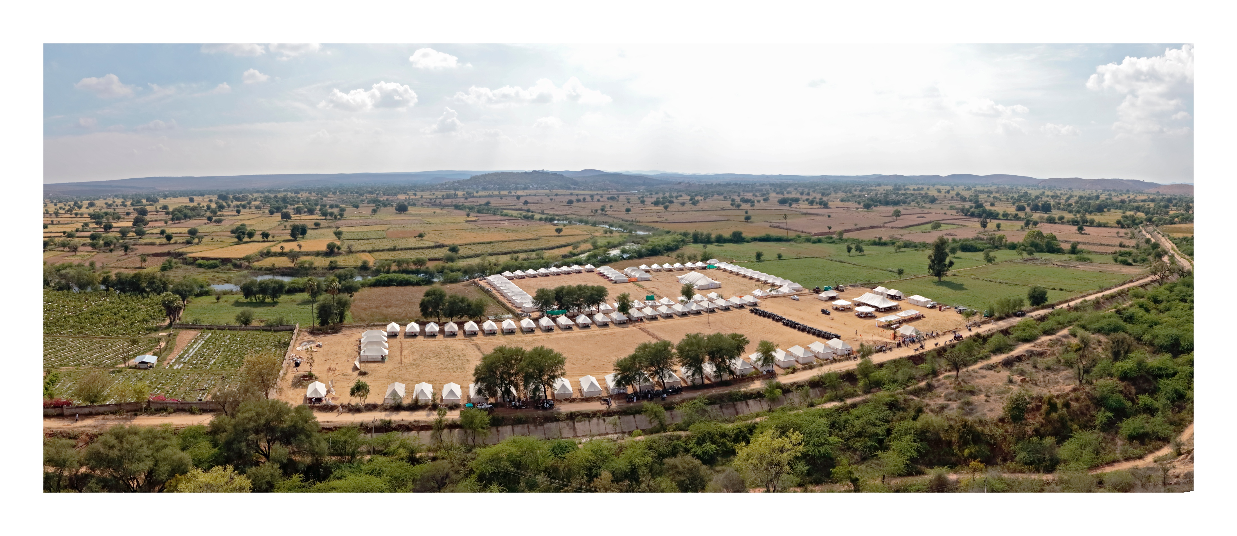

Slide 33
Fact File for Ramathra Fort
Hotel concept: Heritage Fort
No. of Tents / Suites : 12 ( 6 Tents and 6 Suites )
Access : Jaipur: 160 Kms / Agra : 205 Kms / Ranthambhore : 80 Kms
Activities :
Ramathra Village Trail
Bird Watching by the Kalisil Lake
Wilderness drive & Night safaris
Walking trails to Dang plateau
Tea on the Farm
Yoga on the Ramparts

Slide 34
Conscious Luxury

